Slide 1

Lafayette Square February 2026
General Membership Meeting
The neighborhood association of Lafayette Square
Lafayette Square Restoration Committee (LSRC)
Established 1969, Incorporated 1971
aka
Lafayette Square Neighborhood Association (LSNA)
Since 2022

Slide 2

Meeting Rules & Notices
When speaking with a question or a comment, please STAND AND TALK LOUD/USE THE MICROPHONE
Meeting procedures are Robert’s Rule
Meeting minutes are recorded/translated with AI assist

Slide 3
Agenda
Call to Order | 7:00 | Guest Speaker - Jassen Johnson of Renaissance Management Development
Approval of January Meeting Minutes | 7:05 | Board Report President’s Report Treasury Report - 2025 Actuals & Expenses Fundraising - House Tour Status Membership - Safety Improvements Report | asdf
Welcome new residents | 7:10
Community Updates Alderwoman/Jami Antwi SLPD Officer/Rosa Rojas Neighborhood Improvement Specialist/Reign Harris Lafayette Park Conservancy/Tricia Spence Arts Council/Patty Carleton | 7:15 7:25 7:30 7:35 7:50

Slide 4
Approval of Meeting Minutes
For January General Membership Meeting
Is there a motion to approve?
Is there a second?
The minutes are approved,-thank you

Slide 5
New Residents
Welcome to Lafayette Square!!!
Please introduce yourself
Any newborns in our neighborhood?
You are approved as residents!!!!

Slide 6

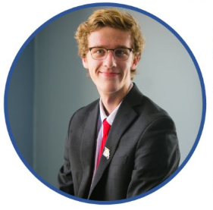

Ward Report
8th Ward Alderwoman
Jami Antwi
Legislative Assistant
AJ Hessburg
coxantwi@stlouis-mo.gov
(314)-762-1944
hessburga@stlouis-mo.gov
(314)-669-4992

Slide 7

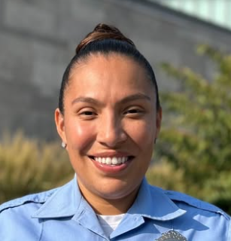
Police Report
Central Patrol District
Officer
Rosa Rojas
DSN 11184
rrojas@slmpd.org
314-444-2595 (Cell)
https://www.facebook.com/SaintLouisMetropolitanPoliceDepartment/

Slide 8
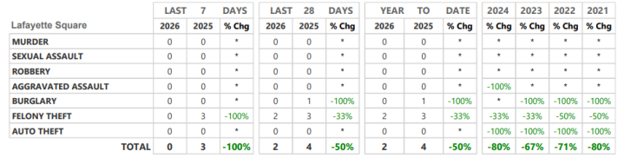
Neighborhood Crime and Activity Report
For 28 days: End February 8th, 2026

Slide 9

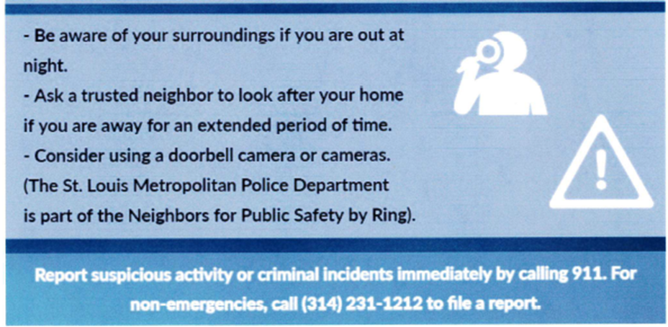
Tips for Winter Crime Prevention

Slide 10


Planned Street Closure
~700 participants
6:30-9:30 am Park Avenue closed at 18th Street
8:00-9:00 am Mississippi and Missouri Streets closed between Lafayette and Park
8:00-9:00 am 1 way westbound traffic open on Park
8:00-9:00 am 1 way eastbound traffic open on Lafayette
https://www.s2fevents.com/stlouisevents/snowball-series-5k-forest-park-98pwp-e9rws-c4g5h
Email sent to membership on February 5th at 9:08 PM

Slide 11
St. Louis Neighborhood Stabilization Division
Neighbor Improvement Specialist
Reign Harris
harrisre@stlouis-mo.gov
(314)-901-3615 (cell)

Slide 12

Lafayette Park Conservancy
President
Tricia Spence
president@lafayettepark.org
(314) 949-2197

Slide 13

Lafayette Arts Council
President
Patty Carleton
acls@lafayettepark.org
(314) 949-2197

Slide 14

Guest Speaker - Jassen Johnson
Owner - Renaissance Development Management
Purchased three properties in Fall 2024 from previous owner
Development progress status

Slide 15
President’s Report - Phil Lamczyk
Accomplishments
Fulfilled the first ever annual meeting (30 January) of Jim King Fund at Modern Dollar Planning with members of subcommittee: Lamczyk, Negri, Hunt, Volpe, Hurst
$200K fund established in November 2020; current value at $249K
First 4% withdrawal in work of ~$9,900; designated for beautification/improvements/landscape
Issues/Open Items
Park House lease expiring at the end of March; city will open bid for lease renewal
  30 January meeting conducted with Alderwomen Antwi (Hessburg) with Spence, Negri, Lamczyk & Hunt to understand city’s plan/intent
  LSRC & LPC will pursue lease with proposal
Seeking two (2) volunteers to support donation disbursement plan to various non-profits; work with ad-hoc committee with a board member; $7K budgeted
president@lafayettesquare.org

Slide 16
Fundraising Report
Chair of Fundraising - Barb Absher
57th Annual Spring Home & Garden Tour
Saturday & Sunday - June 6 & 7 2026
10:00 AM to 5:00 PM
fundraising@lafayettesquare.org; springtour@lafayettesquare.org
House Selection - homeselection@lafayettesquare.org

Slide 17
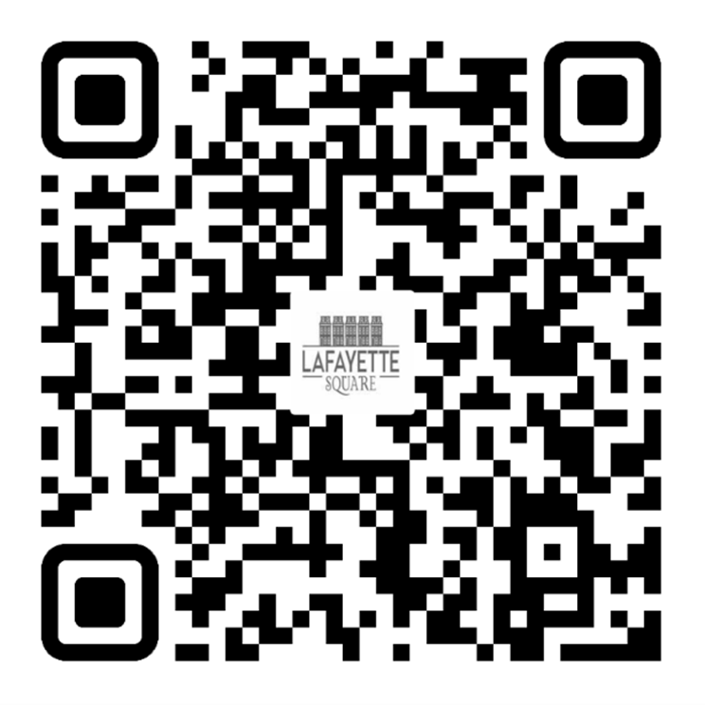
Membership Report
Chair of Membership- Kim Winters
2025 LSNA MEMBERSHIP GOAL:
50 NEW MEMBERSHIPS (350 TOTAL) &
14% OF RESIDENTS ARE LSNA MEMBERS
January 304 / 15%
February 305 / 14%
UNSURE IF YOU ARE A MEMBER OR
DO YOU HAVE QUESTIONS?
membership@lafayettesquare.org
JOIN TODAY

Slide 18
Safety Report - Jeff Kirkpatrick
Chair of Safety - Jeff Kirkpatrick
Planned Street Closure for Saturday 21 February 8:30 AM to 9:30 AM
Snowball Series 1 Mile
6:30-9:30am Park Avenue closed at 18th Street
8:00-9:00am Mississippi and Missouri Streets closed between Lafayette and Park
8:00-9:00am 1 way westbound traffic open on Park
8:00-9:00am 1 way eastbound traffic open on Lafayette
safety@lafayettesquare.org

Slide 19
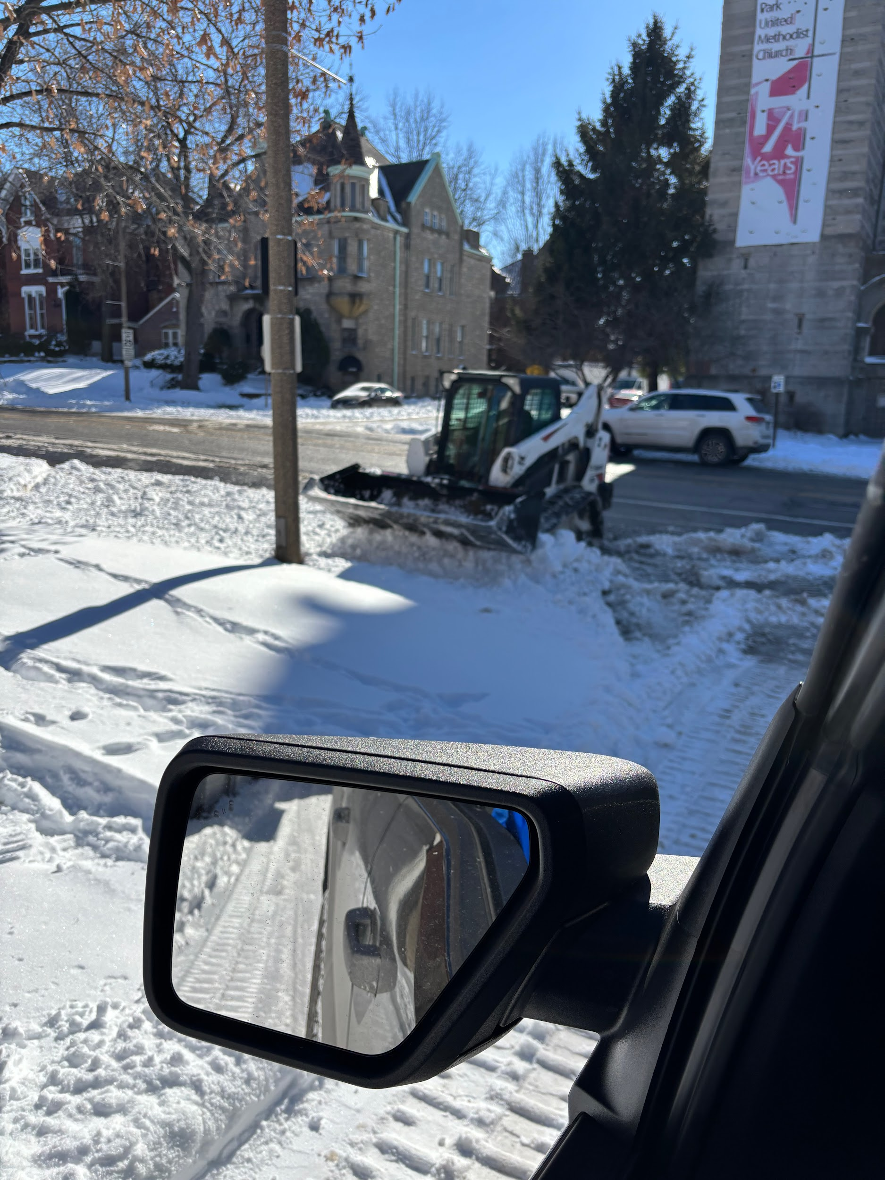
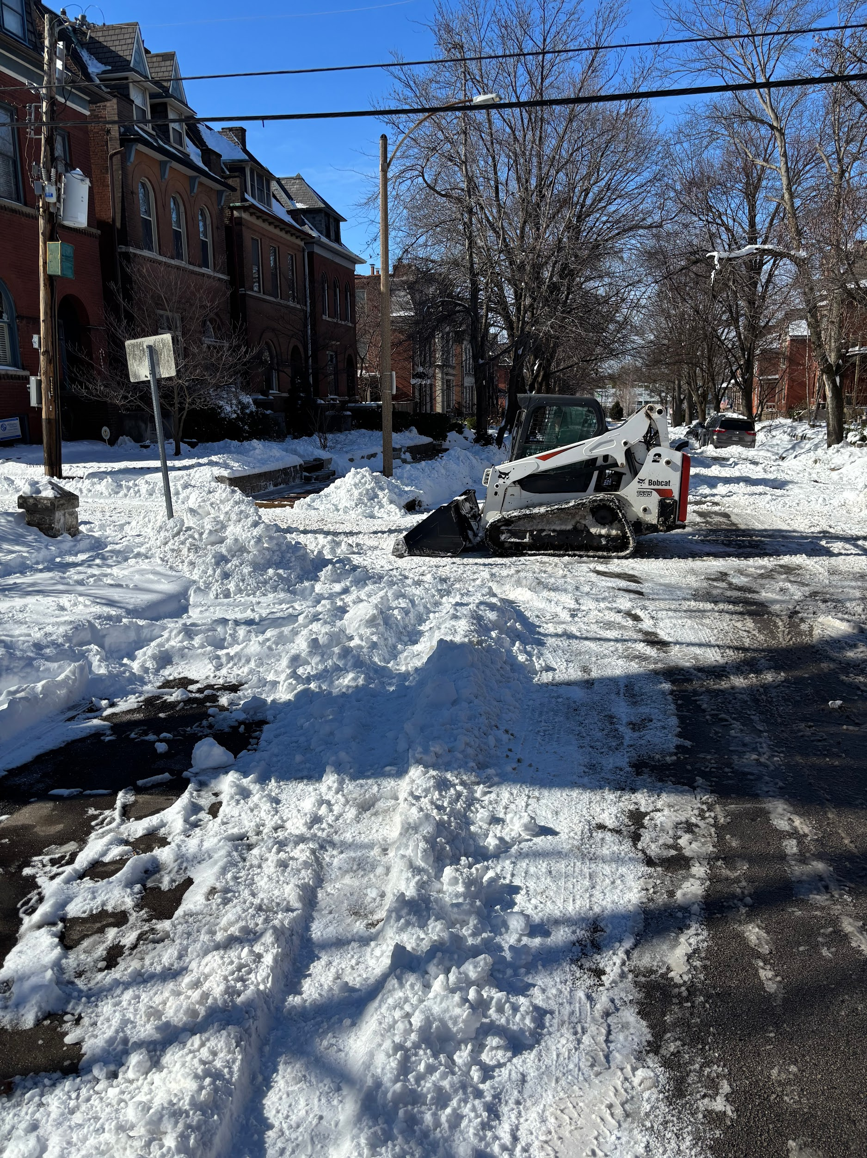
Improvements Report
Chair of Improvement - Mitch Hunt
Snow Removal Plan Execution
First time contract for snow removal during the big snowstorm
Planned/budgeted $15,000
Total invoice cost - $19,975
Lessons learned for the hood and contractor
improvements@lafayettesquare.org

Slide 20
Communications Report
Chair of Improvement - Ben Warner
communications@lafayettesquare.org

Slide 21
Upcoming Events
LPC President’s Day Ceremony: 16 February at Kern Pavilion @ 9:00 AM
Board Retreat: Sunday, February 20th
Board Meeting, Tuesday, March 3rd (reactivated)
General Membership Meeting, March 11th
Spring Home & Garden Tour, Saturday & Sunday, June 6th & 7th

Slide 22
Any Brief Announcements of the Members
•Birthday (significant or otherwise)?
•Anniversary of something?
•Significant life event?
•Complaints?
Petition in back for Respect Missouri Voter initiative

Slide 23
End of Meeting
Is there a motion to adjourn?
Is there a 2nd?
All those in favor?
We are adjourned,-thanks.
TIME TO SOCIALIZE

Slide 24
Backup
Under construction

Slide 25
Backup
Under construction

Slide 26
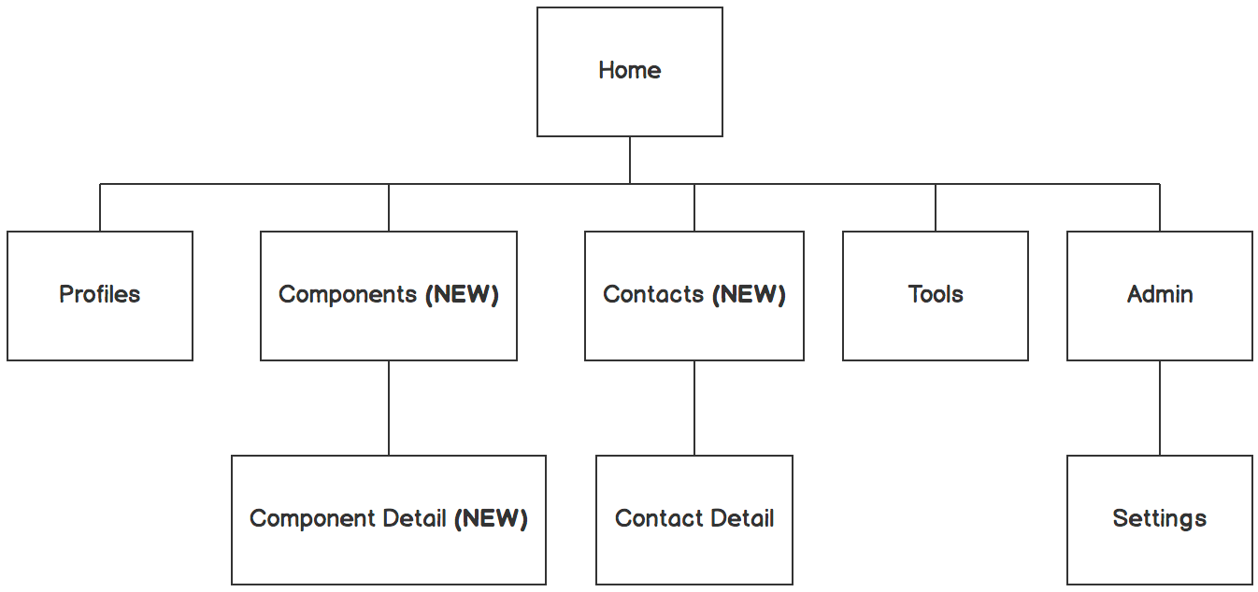

Information architecture
Under construction
Balsamiq Tip | Information architecture is the flow of content across the site or application (more info).

