Slide 1

Membership Meeting Wednesday
December 10, 2025
Lafayette Square Restoration Committee (LSRC)
The neighborhood association
of Lafayette Square
Established 1969.
Incorporated 1971.
dba Lafayette Square Neighborhood Association
(LSNA)
Since 2022

Slide 2
AGENDA
Call to order
Approval of November 12, 2025 minutes
Welcome new residents
Sharing of news
Guest Speakers & Community Updates
Elections: Open board positions
Treasurer’s Report
Membership Update
2026-27 Community Directory
2025 Holiday Parlor Tour
President’s Report
Upcoming Events
Adjournment
Post-Meeting Socializing

Slide 3
Approval of
November 12, 2025
Membership Meeting Minutes
Is there a motion to approve the November minutes?
Is there a second?
The minutes are approved.
Thank you.
Notes:
B

Slide 4
New neighbors:
Welcome to our community!
Please introduce yourself.
Also . . . For anyone else . . .
Something to (briefly) share; but not overshare?
Birthday (significant or otherwise)?
Anniversary of something?
Significant life event?

Slide 5
8th Ward Alderwoman: Jami Cox Antwi
Police Report: Officer Rosa Rojas
Neighborhood Improvement Specialist: Reign Harris
Guest Speakers/ Community Updates

Slide 6
8th Ward Alderwoman:
Jami Cox Antwi
coxantwi@stlouis-mo.gov.
(314) 762-1944

Slide 7


Slide 8
Police Report:
Officer Rosa Rojas
rrojas@slmpd.org
Mobile: 314-444-2595
“I am currently on limited duty due to a car accident where I broke my thumb and required surgery. Any question or concerns you can still email me or contact my number.”

Slide 10
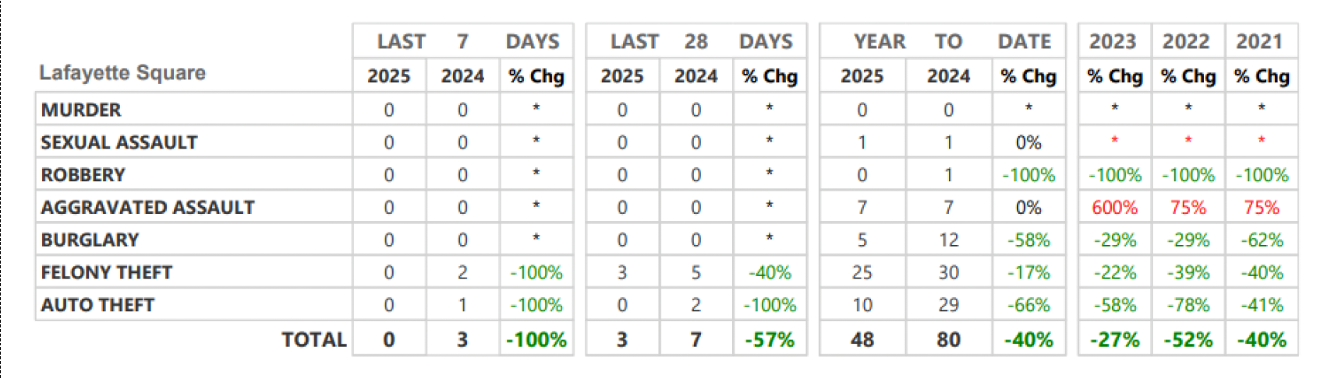
Neighborhood Crime and Activity Report
Lafayette Square
for 28 days: Nov. 10 thru Dec. 7

Slide 12
St. Louis Neighborhood Stabilization Division
Neighborhood Improvement Specialist:
Ms. Reign Harris
harrisre@stlouis-mo.gov
(314) 901-3615 (cell)

Slide 13
Elections: Open board positions
Nominees:
Open 2025 Board Positions (thru 12/31/25):
Vice-President/ President-Elect: Phil Lamczyk
Assistant Treasurer/ Treasurer-Elect: No nominee
Open 2026 Board Positions (starting 1/1/26):
Vice-President/ President-Elect: Gary Larson
Assistant Treasurer/ Treasurer-Elect: Matt Krieg
Member-at Large #3: (2-year term: 2026-27): Caleb Haydon
Member-at Large #4: (2-year term: 2026-27): Marc Fine

Slide 14
Treasurer’s Report:
Gary Larson
treasurer@lafayettesquare.org

Slide 15
Treasurer’s Report: Gary Larson
1. Cash
2. 2025 YTD
3. 2026 Budget Process

Slide 16
Membership Chair:
Kim Winters
membership@lafayettesquare.org

Slide 17
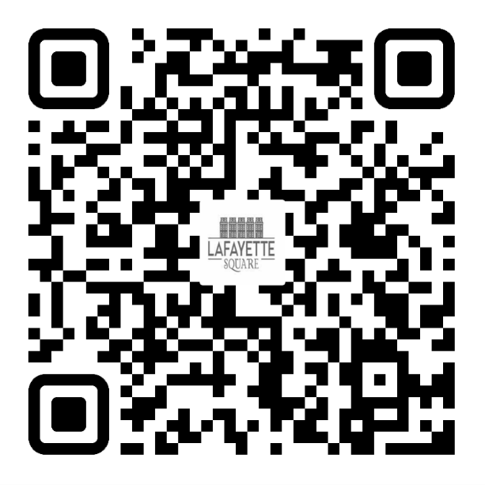
2025 LSNA MEMBERSHIP GOAL:
50 NEW MEMBERSHIPS (350 TOTAL) &
18% OF RESIDENTS ARE LSNA MEMBERS
November: 316/ 15%
December 309/ 14%
JOIN TODAY!
UNSURE IF YOU ARE A MEMBER OR
DO YOU HAVE QUESTIONS?
PLEASE EMAIL ME AT:
MEMBERSHIP@LAFAYETTESQUARE.ORG

Slide 18
2026-27 Community Directory:
Donna Hagerty-Payne
dhpheartbeat@aol.com

Slide 19
Holiday Parlor Tour Chair:
Barbara Absher
holidaytour@lafayettesquare.org

Slide 20
48th Annual Holiday Parlor Tour
Sunday, December 14, 2025
10:00 am to 4:00 pm
2025 Holiday Parlor Tour Chair:
Barbara Absher
holidaytour@lafayettesquare.org
(314) 322-8152

Slide 21
48th Annual Holiday Parlor Tour
We’ve sold out – 2,501 tickets: expect to raise about
$100,000 in ticket sales, poster sales & holiday market fees.
Proceeds for restoration & preservation, improvements, and safety
Needed 130 docents and 35 other volunteers
Filled 91% of those slots – THANK YOU!
Still need 15 more volunteers:
6 Docents
2 Tickets/ Check-in for 9:00 am to Noon
6 Tickets/ Check-in for Noon – 2:00 pm
1 Merchandise for 2:00 pm – 4:00 pm
After Party @ 5:00 pm for Homeowners, Docents, Other Volunteers
Neighbors: Please ensure your sidewalks are clear
THESE TOURS ARE A LABOR OF LOVE FROM ALL INVOLVED. PLEASE VOLUNTEER!!

Slide 22
President’s Report:
Vince Volpe
president@lafayettesquare.org

Slide 23
President’s Report: Vince Volpe
57th Annual Spring Home & Garden Tour
(Sat. June 6 and Sun. June 7)
Salting/ Snow Removal: Update on identifying contractor
2026 Anniversaries
Bylaws ad hoc committee
”Special Properties” ad hoc committee
Culture and Engagement

Slide 24
57th Annual
Spring Home & Garden Tour
(Sat. June 6 and Sun. June 7)
Looking for a volunteer to chair the tour.
Chair will have support from existing tour committee members.
Home selection is underway

Slide 25
Salting/ Snow Removal Update
No contract at this point.
In touch with several contractors.
Still need a reputable contractor with both the capacity and the appropriate insurance coverage.

Slide 26
2026 Anniversaries
190th Anniversary: In 1836, the land for what became Lafayette Park was set aside as a green space when the St. Louis Commons was broken into lots that were sold.
175th Anniversary: In 1851, Lafayette Park was dedicated as a public park by the City of St. Louis.
25th Anniversary: The Lafayette Park Conservancy was founded in 2001 (on the 150th anniversary of the dedication).
FYI: In 2025, we missed out by not celebrating the 200th Anniversary of the Marquis de Lafayette’s April 29, 1825 visit to St. Louis.

Slide 27
Bylaws Ad Hoc committee
Gaps and confusion in current bylaws; need to avoid patchwork amendments
Governance structure weaknesses:
Currently: 17-member volunteer board is too large
Need fewer board meetings
Need longer board terms: improved institutional knowledge; less re-invention/ chasing bright shiny objects
Clarification of oversight v. operations management
Clearer accountability for volunteer assignments

Slide 28
“Special Properties” Ad Hoc committee
Seven “special properties” in the Historic District
Need to gather and update information re:
Awareness: Creating awareness of these properties in the Historic District;
Ownership: Understanding who owns them and what plans (if any) the owners have for developing or selling the properties;
Costs: Tracking what operating costs or capital expenditures the LSRC may already be assuming (or may end up assuming) for each of these properties; and
Action: Deciding what actions, if any, the LSRC might be able to take regarding the development or sale of these properties.

Slide 29
“Special Properties”
Fountain Plaza
Owner: Near Southside Improvement Corporation – “NSIC” (formerly the “TIF”)
Community Garden (1701-07 Park / 1319 Dolman)
Owner: Seed St. Louis, a nonprofit (fka “Gateway Greening”)
LSRC: Is the ”Custodian” – collects garden fees, etc.
Vacant lots at 1100 Mississippi (west side of Mississippi)
Owner: Lafayette Walk HOA
Parking lot at 1700 block of Chouteau
Three Owners: NSIC (formerly “the TIF”), Streets Dept. & LRA
1910 & 1922 Park Avenue – aka “pocket park” (SE corner of Park & Mississippi)
Owner: LSRC (since 12/22/21)
Southeast corner of Dolman & Hickory (1200 to 1210 Dolman
Owner: St. Mary’s Assumption Church
Chouteau vacant lots (between Missouri and the ZX station)
Owner: Chouteau Avenue Partners

Slide 30
2026 Recap
Updated and revised the website
Spring Home & Garden Tour: Revived after 5 years without.
Holiday Parlor Tour: 4th consecutive post-Covid holiday tour
New Residents Social: Revived after 5 years without
New Police Substation: Leased 1817 Park Avenue
Vicini seasonal lease of eastern half of “pocket park”
2320 Chouteau Public Storage Facility: Ongoing fight
Restructured budget accountability and budget process
Emphasized laser focus on:
Restoration and Preservation, Improvements, & Safety

Slide 31
Culture
The board is the custodian of
the financial and cultural resources of the organization.
“Culture” defies easy definition. It is a “I-know-it-when-I-see-it” phenomenon
A neighborhood can develop a distinctive culture, just as a culture takes root over time in a nation, city, company, family, house of worship, or school.
The touchstones of culture include origin stories, the name of the organization, historical milestones, tales of trial and triumph, heroes, traditions, celebrations, and an emphasis on connection and belonging, which encourages communication and an expectation for engagement.

Slide 32
Engagement
Stay informed: attend monthly meetings, read emails, visit the website, read the Marquis, talk with your neighbors
Ask questions
Follow up
Volunteer

Slide 33
My Engagement
Moved here in 1975
Treasurer 1976-77
Spring House Tour Chair in 1979
Put my home on 4 or 5 tours thru 2004; occasional volunteer
Didn’t do much else for decades. Relied on others to do things.
Spring 2022: Started paying attention:
– no “Community Directory” (touched a “third rail”) and heard about something called the “LSNA”
On Spring 2023 “Garden Tour” – Discovered no homes on the tour
January 2024: Opposed board’s cancellation of Spring 2024 tour
May 2024: Volunteered to fill vacant VP/ President-Elect position
Since January 2025: President, Fundraising Chair, Spring Tour Chair

Slide 34
The “LSRC”
Lafayette Square Restoration Committee (LSRC)
The neighborhood association of Lafayette Square
Established 1969.
Incorporated 1971.
dba Lafayette Square Neighborhood Association
(LSNA)
Since 2022

Slide 35
The “LSNA” name change came during the
two years when the board and members were
meeting via Zoom.
At one of the last pre-Covid in-person monthly neighborhood meetings, the idea of changing the name was floated by board members but was met with great resistance and the board members quickly backed down.
However, in August 2021, when no one was paying much attention, the board president filed a dba with the Secretary of State.
“No one else was in the Zoom where it happened.”

Slide 36
You should change
an identity/ brand/ tradename:
When the current name is:
Offensive
Misleading or
Irrelevant
None of those were a reason for the dba filing in August 2021.

Slide 37
This was a solution in search of a problem.
Here were the “problems” the board identified:
No one knew what LSRC was. People were confused.
The word “committee” didn’t make any sense.
The word “restoration” was no longer important. We’ve moved beyond “restoration” here.
”Restoration” is at the core of our reason for being here.
It is like trying to eliminate “Italian” on The Hill

Slide 38
Chose a name similar to other neighborhoods.
Claim: LSNA name was OK because the LSRC was once named “Lafayette Square Neighborhood Association”
Not true. On the contrary, the LSRC was formed in 1969 as a counterweight to an existing “Lafayette Park Neighborhood Association” that was not concerned with restoration of homes or buildings here.
“Lafayette Square Neighborhood Association” is a generic and soulless name.

Slide 39
A organization’s name is very important:
Ties to an origin story
Tells people who you are/ what you care about
Differentiates you from others
It’s one of the linchpins of a community’s culture
Everyone lives in a neighborhood; what we’ve created here over these last 6 decades is a community.

Slide 40
Lafayette Square Restoration Committee
(LSRC)
The neighborhood association of Lafayette Square
Established 1969.
Incorporated 1971.
dba Lafayette Square Neighborhood Association
(LSNA)
Since 2022

Slide 41
Lafayette Square Restoration Community
(LSRC)
The neighborhood association of Lafayette Square
Established 1969.
Incorporated 1971.

Slide 42
Upcoming Events
Holiday Parlor Tour (48th Annual): Sun. December 14^{th –} 10 am to 4 pm
Board Meeting: Tue. January 6 @ 7:00 pm
General Meeting: Wed. January 14th @ 7:00 pm
Spring Home & Garden Tour (57th Annual): Sat. June 6 & Sun. June 7, 2026

Slide 43
Any Brief Announcements?

Slide 44
Adjournment
Is there a motion to adjourn?
Is there a second?
Vote.
We are adjourned.
Thank you.
TIME TO SOCIALIZE !!

