Slide 1

Membership Meeting Wednesday
September 10, 2025
Lafayette Square Restoration Committee (LSRC)
The neighborhood association
of Lafayette Square
Established 1969.
Incorporated 1971.
dba Lafayette Square Neighborhood Association
(LSNA)
Since 2022

Slide 2
AGENDA
Call to order
Approval of August 13, 2025 minutes
Welcome new residents
Sharing of news
Guest Speakers & Community Updates
President’s Report
2025 Holiday Parlor Tour
Membership Report
Nominations for October Elections
Upcoming Events
Adjournment
Post-Meeting Socializing

Slide 3
Approval of
August 13, 2025
Membership Meeting Minutes
Is there a motion to approve the August minutes?
Is there a second?
The minutes are approved.
Thank you.

Slide 4
New neighbors:
Welcome to our community!
Please introduce yourself.
Also . . . For anyone else . . .
Something to (briefly) share; but not overshare?
Birthday (significant or otherwise)?
Anniversary of something?
Significant life event?

Slide 5
Guest Speakers/ Community Updates
8th Ward Alderwoman: Jami Cox Antwi
Police Report: Officer Rosa Rojas
Neighborhood Improvement Specialist: Reign Harris
Lafayette Park Conservancy: Michael Bushur
Arts Council of Lafayette Square

Slide 6
8th Ward Alderwoman:
Jami Cox Antwi
coxantwi@stlouis-mo.gov.
(314) 762-1944

Slide 7
Police Report:
Officer Rosa Rojas
rrojas@slmpd.org
Mobile: 314-444-2595

Slide 9
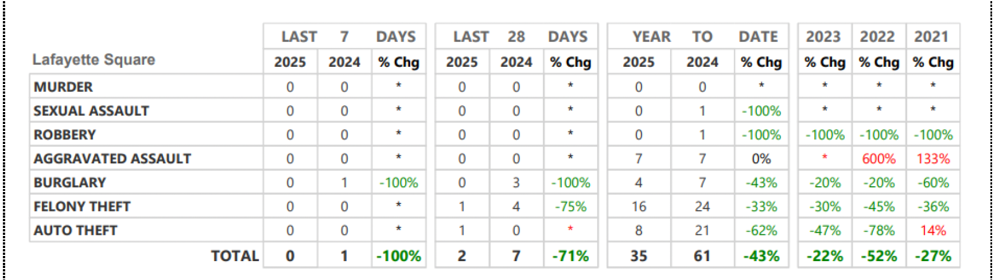
Neighborhood Crime and Activity Report
Lafayette Square
for 28 days: August 4 through August 31, 2025

Slide 10
St. Louis Neighborhood Stabilization Division
Neighborhood Improvement Specialist:
Ms. Reign Harris
harrisre@stlouis-mo.gov
(314) 901-3615 (cell)

Slide 11
Lafayette Park Conservancy (LPC)
Executive Director:
Michael Bushur
michael.bushur@lafayettepark.org
(314) 949-2210

Slide 12
Back to . . . Community Updates
8th Ward Alderwoman: Jami Cox Antwi
Police Report: Officer Rosa Rojas
Neighborhood Improvement Specialist: Reign Harris
Lafayette Park Conservancy: Michael Bushur
Arts Council of Lafayette Square

Slide 13
President’s Report:
Vince Volpe
president@lafayettesquare.org

Slide 14
President’s Report: Vince Volpe
Vicini lease extension: from 8/31/25 to 10/19/25
1817 Park Avenue Police Substation
National Night Out: Tuesday, October 7th
2350 Chouteau: Revised Proposal
“Square Roots”
Holiday Parlor Tour: Sunday, 12/14/25
Nominations for 2026 Board and Preservation Committee

Slide 15
National Night Out & Block Captains:
Wayne White
wmw@studio2108.com

Slide 17
2350 Chouteau (SE corner of Jefferson)
24/7 Public Storage Proposal
Although a building permit was denied for the original proposal for a public storage facility at 2350 Chouteau Avenue, a revised proposal has been submitted.
In an attempt to meet “mixed use” for zoning, the revised proposal includes five (5) small “residential lofts” and three (3) small “office/ commercial” spaces on the south (LaSalle) side of the property.

Slide 19
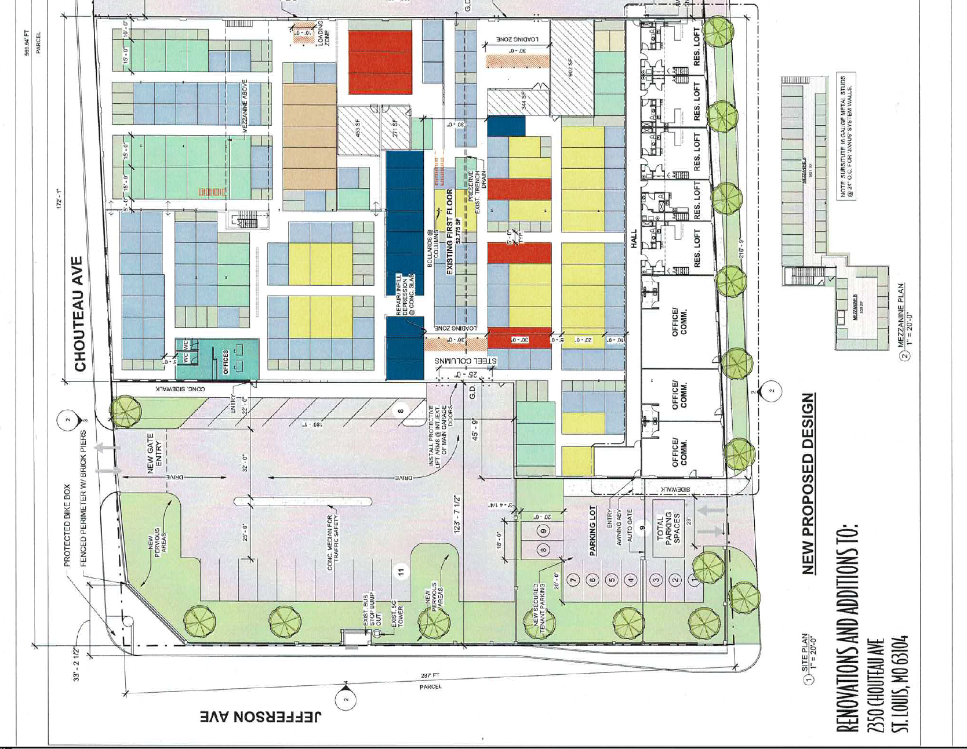

Slide 20
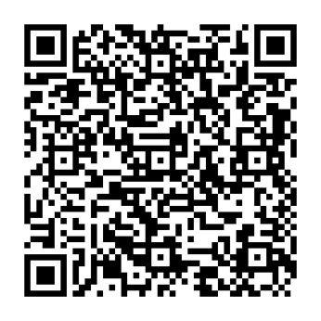
“Square Roots”
We want to celebrate you and your time here!
Whether 2025 marks one year here or 51 years here, we want to include you in a listing of anniversaries of how long each person has
lived in the Lafayette Square restoration community. Look for this Annual Celebratory Listing in the November issue of the Marquis.
Please use this QR code NLT October 15th to provide name, address, and year you moved to Lafayette Square!
Or go to: http://lafayettesquare.org/square-roots

Slide 21
48th Annual Holiday Parlor Tour
Sunday, December 14, 2024
10:00 am to 4:00 pm
2025 Holiday Parlor Tour Chair: Barbara Absher
holidaytour@lafayettesquare.org
(314) 322-8152

Slide 22
Membership Chair:
Kim Winters
membership@lafayettesquare.org

Slide 23
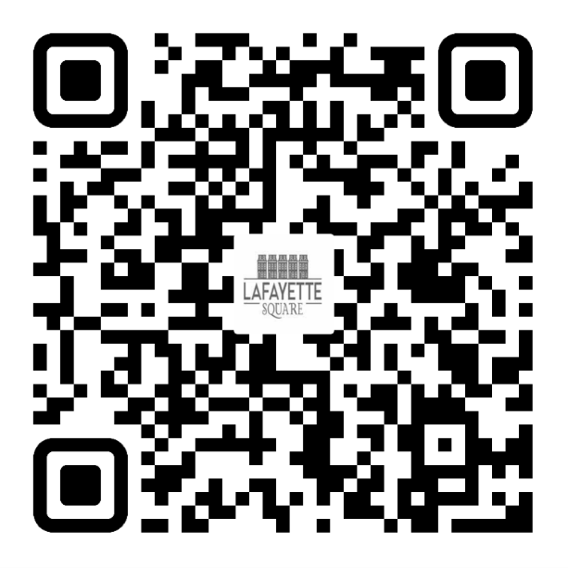
2025 LSNA MEMBERSHIP GOAL:
50 NEW MEMBERSHIPS (350 TOTAL) &
18% OF RESIDENTS ARE LSNA MEMBERS
AUGUST: 316/ 15%
September: 319/ 15%
JOIN TODAY!
UNSURE IF YOU ARE A MEMBER OR
DO YOU HAVE QUESTIONS?
PLEASE EMAIL ME AT:
MEMBERSHIP@LAFAYETTESQUARE.ORG

Slide 24




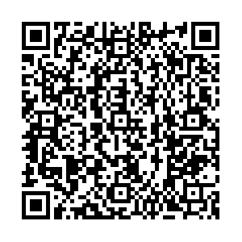

NEW RESIDENT SOCIAL
2025
Welcome to The Square
Continuing the tradition
of welcoming NEW RESIDENTS who have moved to
on / after Jan. 1st, 2024
The Square
Join us at THE PARK HOUSE for Family Fun & Food
Saturday, Sept. 27th 5pm – 9pm
!!! FREE !!!
Hamburgers, Hot dogs, Chips & Popcorn
+
+
Please bring lawn chairs and blankets
RSVP by September 20th
To
welcomesocial@lafayettesquare.org
Presented by:
Neighborhood Association
***If the event is impacted by rain/inclement weather, check the event page on the Lafayette Square Website or our Facebook page***

Slide 25
Annual Elections during:
October 8th Annual Meeting
  Nominations were open at: August 13th Membership Meeting
  Nominations close at end of: Sep. 10th Membership Meeting
  Nominations accepted at October 8th meeting for any positions for which there were no previous nominations.

Slide 26
Nominations by the Board of Directors (per Article VIII.5. of the bylaws)
Under the bylaws, these three people will automatically assume the following 2026 positions and no election is required:
President: Butch Young
Chair for Preservation: Mark Kapp
Immediate Past President: Vince Volpe

Slide 27
Nominations by the Board of Directors (per Article VIII.5. of the bylaws)
  From the August 13th meeting –
  Nominations for these Board Positions – 1-year terms:
  Vice President/ President-Elect – No nominee
  Treasurer – Fanny Chang
  Assistant Treasurer/ Treasurer-Elect – Gary Larson
  Secretary – Jenn Whitter
  Chair for Business Affairs – Bart Lissner
  Chair for Communications – Ben Warner
  Chair for Preservation-Elect – Jake Haggmark
  Chair for Fundraising – No nominee
  Chair for Improvements – Mitch Hunt
  Chair for Membership – Kim Winters
  Chair for Safety – Jeff Kirkpatrick

Slide 28
Nominations by the Board of Directors (per Article VIII.5. of the bylaws)
  Nominations for these 2-year Board Positions
Member-at-Large #3: No Nominee (2-year term: 2026-2027)
Member-at-Large #4: No Nominee (2-year term: 2026-2027)
    Nominations for three Preservation Committee Members
    (for a 2-year term: 2026-2027)
Member – Matt Negri
Member – Katarina Michalova
Member – Travis Gocken

Slide 29
Nominations are now open . . .
Are there any nominations for:
  Vice President/ President-Elect
  Treasurer
  Assistant Treasurer/ Treasurer-Elect
  Secretary
  Chair for Business Affairs
  Chair for Communications
  Chair for Preservation-Elect
  Chair for Fundraising
  Chair for Improvements
  Chair for Membership
  Chair for Safety
  Member-at-Large #3 (2-yr term)
  Member-at-Large #4 (2-yr term)
  Preservation Committee:
  Member (2-yr term)
  Member (2-yr term)
  Member (2-yr term)

Slide 30
Upcoming Events
Board Meeting: Tue. September 30th 7:00 pm
National Night Out: Tue. October 7th 6:00 pm to 9:30 pm
General Meeting: Wed. October 8th 7:00 pm
Soiree for the Park: Fri. September 19th 6:00 to 9:00 pm
New Residents Social: Sat. September 27th 5:00 pm
Fall Festival: Sun. October 19th Noon to 4:00 pm
Light Up the Square/Pet Parade: Sat. December 6th
Holiday Parlor Tour (48th Annual): Sun. December 14th
  Spring Home & Garden Tour (57th Annual): Sat. June 6 & Sun. June 7, 2026

Slide 31
Any Brief Announcements?

Slide 32
Adjournment
Is there a motion to adjourn?
Is there a second?
Vote.
We are adjourned.
Thank you.
TIME TO SOCIALIZE !!

