Slide 1

Membership Meeting Wednesday
November 12, 2025
Lafayette Square Restoration Committee (LSRC)
The neighborhood association
of Lafayette Square
Established 1969.
Incorporated 1971.
dba Lafayette Square Neighborhood Association
(LSNA)
Since 2022

Slide 2
AGENDA
Call to order
Approval of October 8, 2025 minutes
Welcome new residents
Sharing of news
Guest Speakers & Community Updates
Elections for Calendar 2026
Safety Report
President’s Report
Treasurer Report
Membership Report
2025 Pet Parade/ Light Up the Square
2025 Holiday Parlor Tour
Upcoming Events
Adjournment
Post-Meeting Socializing

Slide 3
Approval of
October 8, 2025
Membership Meeting Minutes
Is there a motion to approve the September minutes?
Is there a second?
The minutes are approved.
Thank you.

Slide 4
New neighbors:
Welcome to our community!
Please introduce yourself.
Also . . . For anyone else . . .
Something to (briefly) share; but not overshare?
Birthday (significant or otherwise)?
Anniversary of something?
Significant life event?

Slide 5
Guest Speakers/ Community Updates
Board of Alderman President: Megan Green
8th Ward Alderwoman: Jami Cox Antwi
Police Report: Officer Rosa Rojas
Neighborhood Improvement Specialist: Reign Harris
Lafayette Park Conservancy: Tricia Spence

Slide 6
Board of Alderman President:
Megan Green
boa-president@stlouis-mo.gov,
(314) 622-4114

Slide 7
8th Ward Alderwoman:
Jami Cox Antwi
coxantwi@stlouis-mo.gov.
(314) 762-1944

Slide 8
Police Report:
Officer Rosa Rojas
rrojas@slmpd.org
Mobile: 314-444-2595

Slide 10
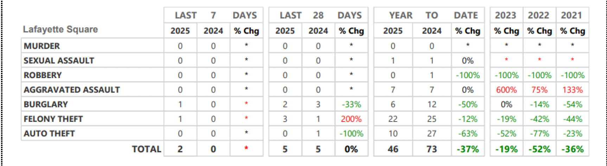
Neighborhood Crime and Activity Report
Lafayette Square
for 28 days: October 13 thru November 9, 2025

Slide 12
St. Louis Neighborhood Stabilization Division
Neighborhood Improvement Specialist:
Ms. Reign Harris
harrisre@stlouis-mo.gov
(314) 901-3615 (cell)

Slide 13
Lafayette Park Conservancy (LPC)
President:
Tricia Spence
president@lafayettepark.org
(314) 949-2197

Slide 14
Back to . . . Community Updates
Board of Alderman President: Megan Green
8th Ward Alderwoman: Jami Cox Antwi
Police Report: Officer Rosa Rojas
Neighborhood Improvement Specialist: Reign Harris
Neighborhood Improvement Specialist: Tricia Spence

Slide 15
Chair of Safety Report:
Jeff Kirkpatrick
safety@lafayettesquare.org

Slide 16
President’s Report:
Vince Volpe
president@lafayettesquare.org

Slide 17
President’s Report: Vince Volpe
Open Board Positions
Salting/ Snow Removal Update
“Square Roots” listing
Strategic Focus
Management
Covid-era Developments
Special Properties

Slide 18
Open 2025 Board Positions (thru 12/31/25):
Vice-President/ President-Elect
Assistant Treasurer/ Treasurer-Elect
Open 2026 Board Positions (starting 1/1/26):
Vice-President/ President-Elect
Assistant Treasurer/ Treasurer-Elect
Member-at Large #4: (2-year term: 2026-2027)
We plan to have nominees for the 2026 board positions brought to the membership for election at the December 10th monthly meeting.

Slide 19
Salting/ Snow Removal Update
No contract at this point.
The contractor we had identified did not have appropriate insurance coverage.
We continue to seek a reputable contractor with appropriate insurance coverage.

Slide 20
“Square Roots”
We had 201 completed submissions for this inaugural listing. -→201 submissions = 344 of our residents.
Look for this Annual Celebratory Listing in the November issue of the Marquis that should be delivered on November 14th.
If we missed you, please submit your name(s), address, and year you moved to Lafayette Square at: http://lafayettesquare.org/square-roots and we will include you in the updated “Square Roots” listing published at the end of next year.

Slide 21
Strategic Focus
Improvements: Public improvements to the streets, alleys, and sidewalks in Lafayette Square
Safety: Police presence, paid patrols, safe streets
Restoration and Preservation: Enforcement of the historic code to ensure the appropriate restoration and preservation of our 19th century residential and commercial buildings as well as our 20th century and 21st century replica homes.

Slide 22
Management
Nine board members have management
responsibilities for specific budget areas:
President
Treasurer
Fundraising
Preservation
Improvements
Safety
Communications
Membership
Business Affairs

Slide 23
Management
Numerous other volunteers have responsibilities
for important budget or activity areas:
Preservation Committee
Problem Properties Committee
Spring Home & Garden Tour Chair & Committee
Holiday Parlor Tour Chair & Committee
Block Captain Coordinator
Community Directory
Sponsorships
Maintenance
Beautification
FB “Blue Dot” & Instagram Manager
Community Garden
Friday Night Social Organizer
Marquis editor
Tour de Lafayette Coordinator

Slide 24
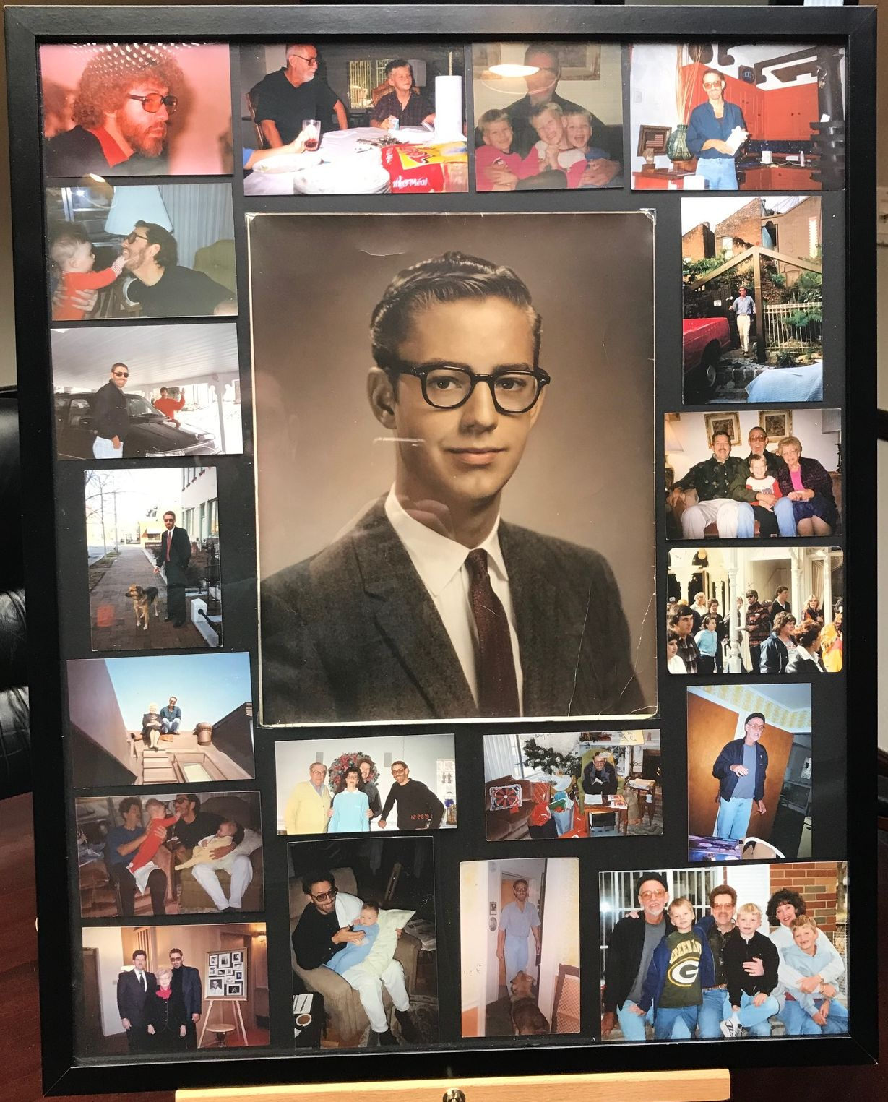
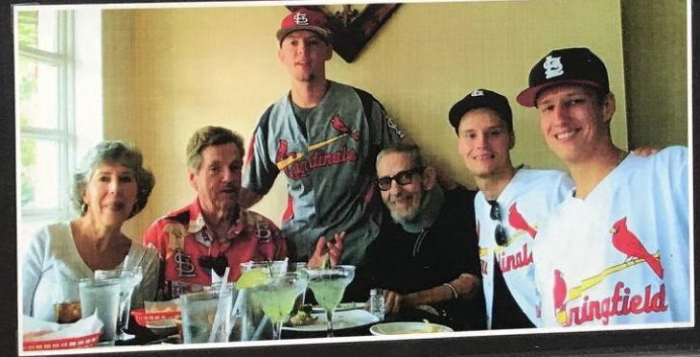
Covid-era Developments
James L. “Jim” King Fund

Slide 25
Covid-era Developments
Jim King Fund
In memory of our neighbor James “Jim” King
Jim was an early pioneer: 1973. Restored home on 18th St.
Talented artist: landscape and interior design
Avid gardener
Lover of animals: rescued animals
Fund was established: 11/17/20 by Paul and Gail King & Jim’s nephews.
$200,000 fund. 4% per year available for sustaining or revitalizing the “Lafayette Square community”
Annual Jim King Pet Parade

Slide 26
Covid-era Developments
1910 & 1922 Park Avenue (aka “pocket park”):
Ownership transferred to LSRC on 12/22/21 by Near Southside Improvement Corporation – NSIC (formerly the ”TIF”)
Those two parcels are likely worth $250,000.
The 2001 Urban Plan shows there will be a building on the SE corner of Park and Mississippi.
In 2022 and 2023, the LSRC board spent $21K plus for landscape architectural plans to develop the “pocket park.”

Slide 27
Covid-era Developments
1910 & 1922 Park Avenue (aka “pocket park”):
Given the 2001 Urban Plan, that was an ill-advised use of funds.
Even without the Urban Plan, our focus should be on the 30-acre park across the street rather than developing and managing a two-lot “pocket park.”
In general, a fully volunteer organization should not be owning and managing property other than what we may need to do re temporary ownership of a ”problem property.”
a

Slide 28
“Special Properties”
Fountain Plaza
Owner: Near Southside Improvement Corporation – “NSIC” (formerly the “TIF”)
Community Garden (1701-07 Park / 1319 Dolman)
Owner: Seed St. Louis, a nonprofit (fka “Gateway Greening”)
LSRC: Is the ”Custodian” – collects garden fees, etc.
Vacant lots at 1100 Mississippi (west side of Mississippi)
Owner: Lafayette Walk HOA
Parking lot at 1700 block of Chouteau
Owner: NSIC (formerly “the TIF”), Streets Dept. & LRA
1910 & 1922 Park Avenue – aka “pocket park”
Owner: LSRC (since 12/22/21)

Slide 29
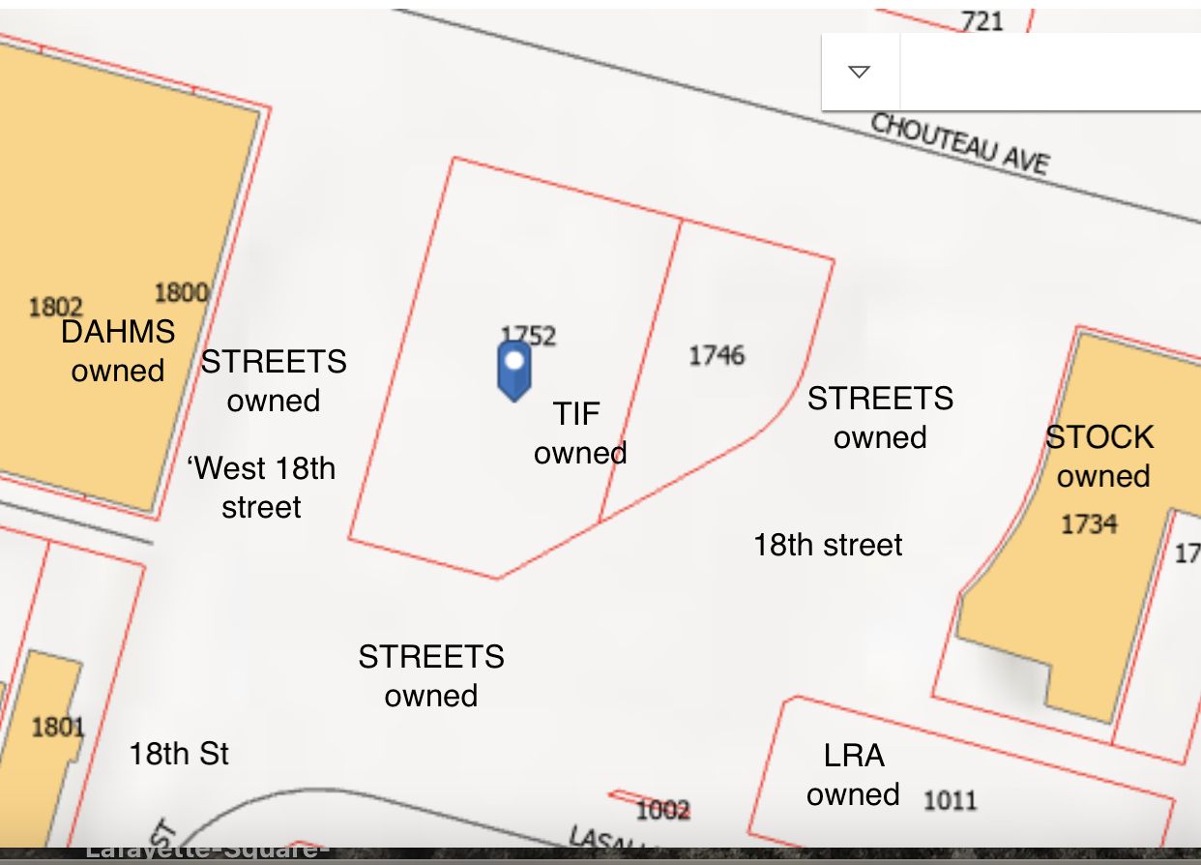
Parking Lot: 1700 block of Chouteau

Slide 30
Treasurer’s Report:
Gary Larson
treasurer@lafayettesquare.org

Slide 31
Treasurer’s Report: Gary Larson
Currently meeting w/ current and incoming officers & chairs
Preparing draft 2026 budget for December 2nd board meeting
Planning to submit 2026 budget to board at January 6th meeting
2026 budget will be presented to membership for approval at January 14, 2026 monthly meeting

Slide 32
Membership Chair:
Kim Winters
membership@lafayettesquare.org

Slide 33
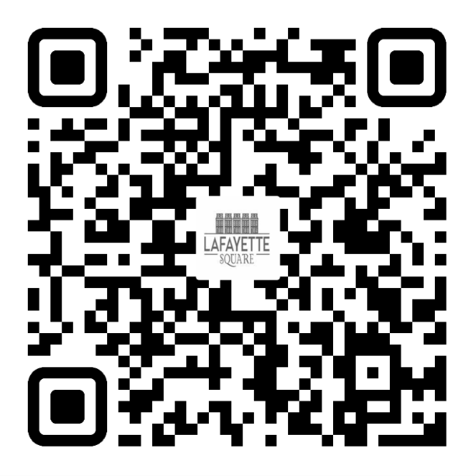
2025 LSNA MEMBERSHIP GOAL:
50 NEW MEMBERSHIPS (350 TOTAL) &
18% OF RESIDENTS ARE LSNA MEMBERS
October: 315/ 15%
November 316/ 15%
JOIN TODAY!
UNSURE IF YOU ARE A MEMBER OR
DO YOU HAVE QUESTIONS?
PLEASE EMAIL ME AT:
MEMBERSHIP@LAFAYETTESQUARE.ORG

Slide 34
Holiday Parlor Tour Chair:
Barbara Absher
holidaytour@lafayettesquare.org

Slide 35
5th Annual Jim King Pet Parade &
Light Up the Square
Saturday, December 6, 2025
3:00 pm: Santa and Mrs. Claus, food, beverages, and much more at Fountain Plaza
3:45 pm: Registration and line up for the Jim King Memorial Pet Parade at the Park House (use QR code: $10 per pet)
4:00 PM to 4:45 PM: Pet Parade
5:00 pm to 5:15 pm: Pet Parade contest winners announced
5:30 pm: Tree Lighting at Fountain Plaza

Slide 36
48th Annual Holiday Parlor Tour
Sunday, December 14, 2025
10:00 am to 4:00 pm
2025 Holiday Parlor Tour Chair: Barbara Absher
holidaytour@lafayettesquare.org
(314) 322-8152

Slide 37
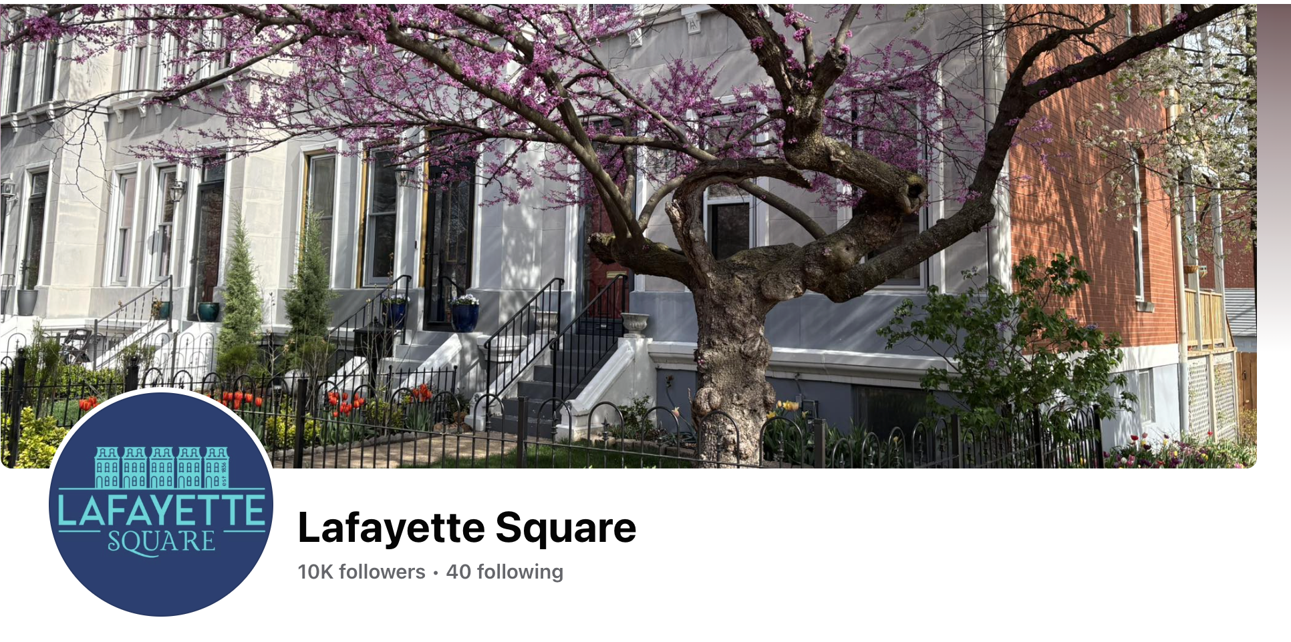
48th Annual Holiday Parlor Tour

Slide 38
Upcoming Events
Board Meeting: Tue. December 2nd @ 6:30 pm
General Meeting: Wed. December 10th @ 7:00 pm
Light Up the Square & 5th Annual Jim King Pet Parade: Sat. December 6th
Holiday Parlor Tour (48th Annual): Sun. December 14^{th –} 10 am to 4 pm
Spring Home & Garden Tour (57th Annual): Sat. June 6 & Sun. June 7, 2026

Slide 39
Any Brief Announcements?

Slide 40
Adjournment
Is there a motion to adjourn?
Is there a second?
Vote.
We are adjourned.
Thank you.
TIME TO SOCIALIZE !!

