Slide 1

Membership Meeting Wednesday
August 13, 2025
Lafayette Square Restoration Committee (LSRC)
The neighborhood association
of Lafayette Square
Established 1969.
Incorporated 1971.
dba Lafayette Square Neighborhood Association
(LSNA)
Since 2022

Slide 2
AGENDA
Call to order
Approval of July 9, 2025 minutes
Welcome new residents
Sharing of news
Guest Speakers & Community Updates
President’s Report
Membership Report
2025 Holiday Parlor Tour
Election for: Treasurer-Elect
Nominations for October Elections
Upcoming Events
Adjournment
Post-Meeting Socializing

Slide 3
Approval of
July 9, 2025
Membership Meeting Minutes
Is there a motion to approve the July minutes?
Is there a second?
The minutes are approved.
Thank you.

Slide 4
New neighbors:
Welcome to our community!
Please introduce yourself.
Also . . . For anyone else . . .
Something to (briefly) share; but not overshare?
Birthday (significant or otherwise)?
Anniversary of something?
Significant life event?

Slide 5
Guest Speakers/ Community Updates
Mayor: Cara Spencer
8th Ward Alderwoman: Jami Cox Antwi
Police Report: Officer Rosa Rojas
Neighborhood Improvement Specialist: Reign Harris
Lafayette Park Conservancy: Michael Bushur
Barr Branch Library: Roxxanne Reed
Arts Council of Lafayette Square
Lafeyette Preparatory Academy: Deidra Arms
LS Community Directory: 2025-2026
Tour de Lafayette
Friday Night Socials

Slide 6
Mayor:
Cara Spencer
Mayor@stlouis-mo.gov
(314) 762-1944

Slide 7
8th Ward Alderwoman:
Jami Cox Antwi
coxantwi@stlouis-mo.gov.
(314) 762-1944

Slide 8

UPDATES
HOW TO CONTACT ME
Neighborhood Priorities
Lafayette Square
  North-West Quadrant Walk
Community Issues
Trash/Recycling
  Public Infrastructure & Utilities Committee Meeting - August 14th, 2025
Neighborhood Associations
Jami’s Community Drop-In
Topic: Parks - August 24th, 2025
Next Board of Alderman Meeting
Board Meeting - September 12th, 2025
www.jamicoxantwi.com
Phone: (314) 762-1944‬
City Information
Email: coxantwi@stlouis-mo.gov
Phone: (314) 622-3287
Legislative Assistant: AJ Hessburg hessburga@stlouis-mo.gov
Secretary: Teresa Ernst
ErnstT@stlouis-mo.gov

Slide 9
Police Report:
Officer Rosa Rojas
rrojas@slmpd.org
Mobile: 314-444-2595

Slide 10
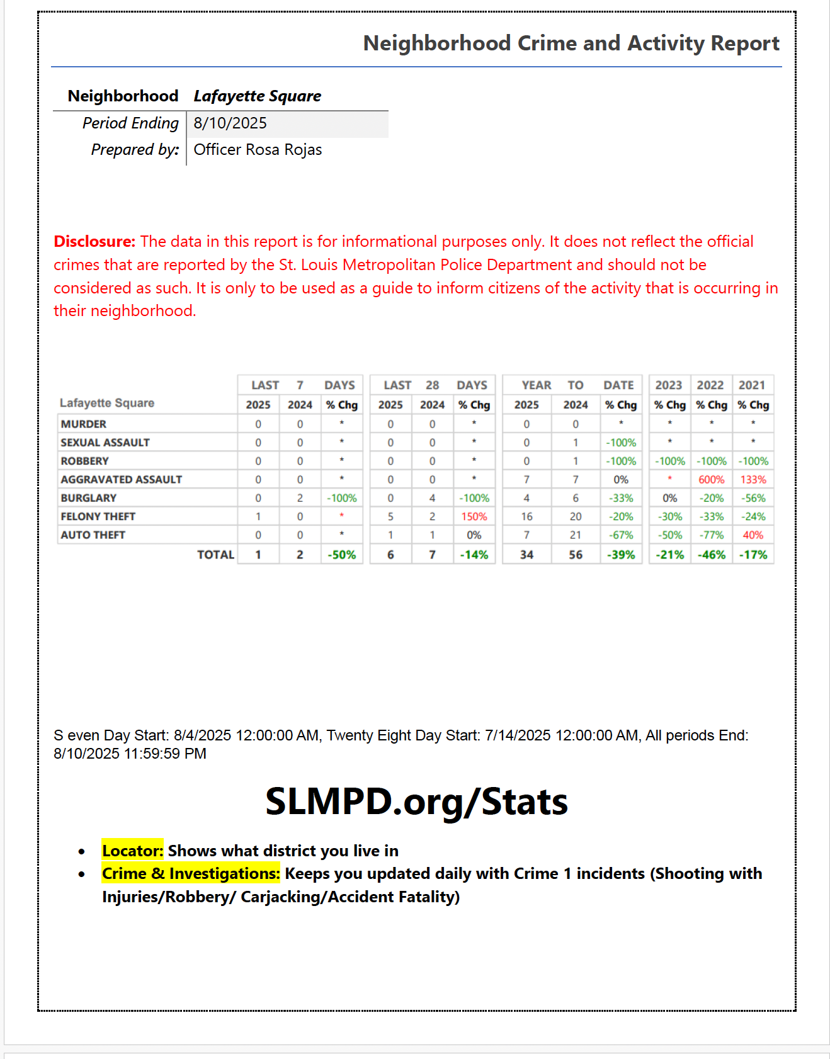

Slide 11
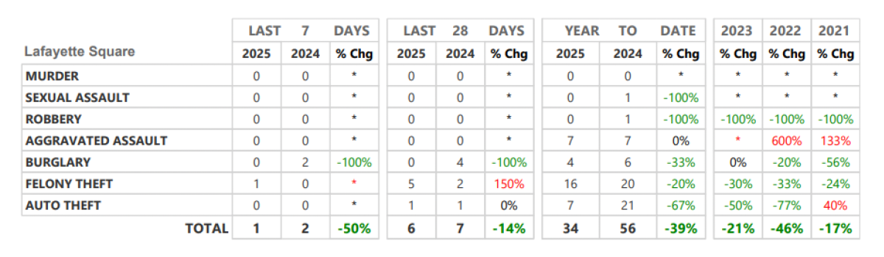
Neighborhood Crime and Activity Report
Lafayette Square
for 28 days: July 14 through August 10, 2025

Slide 12
St. Louis Neighborhood Stabilization Division
Neighborhood Improvement Specialist:
Ms. Reign Harris
harrisre@stlouis-mo.gov
(314) 901-3615 (cell)

Slide 13
Lafayette Park Conservancy (LPC)
Executive Director:
Michael Bushur
michael.bushur@lafayettepark.org
(314) 949-2210

Slide 14
Barr Branch Library
Branch Manager:
Roxxanne Reed
rreed@slpl.org
314‑241‑2288 x3086

Slide 15
Back to . . . Community Updates
Mayor: Cara Spencer
8th Ward Alderwoman: Jami Cox Antwi
Police Report: Officer Rosa Rojas
Neighborhood Improvement Specialist: Reign Harris
Lafayette Park Conservancy: Michael Bushur
Barr Branch Library: Roxxanne Reed
Arts Council of Lafayette Square
Lafeyette Preparatory Academy: Deidra Arms
LS Community Directory: 2025-2026
  Any mistakes?
  Contact Donna Hagerty-Payne at: dhpheartbeat@aol.com
Tour de Lafayette – Fri. 8/29: Julie Padberg-White
Friday Night Socials: Marlane Budde [See next slide]

Slide 16
Friday Night Socials
Final two of 2025:
8/22: Andrea & Josh Grey, 1815 Lafayette
9/05: Dale & Tricia Spence, 2013 Park Ave.

Slide 17
President’s Report:
Vince Volpe
president@lafayettesquare.org

Slide 18
2350 Chouteau (SE corner of Jefferson)
24/7 Public Storage Proposal
On Wednesday, July 23rd, the Board of Adjustment, in a unanimous decision, denied the appeal of the Building Commissioner's decision that denied a building permit that would have authorized the plans for a public storage facility at 2350 Chouteau Avenue.

Slide 19
“Square Roots”
We want to celebrate you and your time here!
Whether 2025 marks one year here or 51 years here, we want to include you in a listing of anniversaries of how long each person has lived in the Lafayette Square restoration community.
This Annual Celebratory Listing will be published in the November 2025 issue of the Marquis.
There will be a QR code (and a web link) in the August issue of the Marquis for you to provide your name, address, month and year you first moved to Lafayette Square.

Slide 20
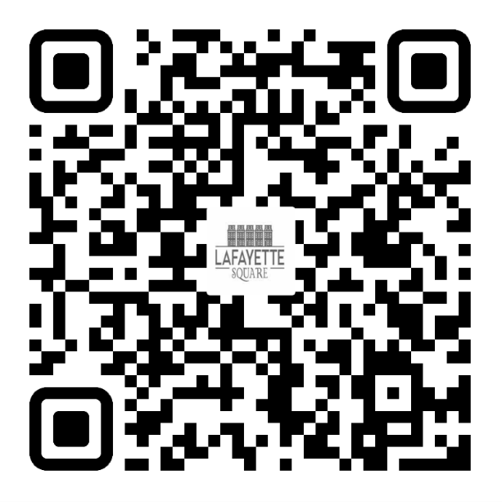
2025 LSNA MEMBERSHIP GOAL:
50 NEW MEMBERSHIPS (350 TOTAL) &
18% OF RESIDENTS ARE LSNA MEMBERS
JULY: 315 MEMBERSHIPS / 15%
AUGUST: 316 MEMBERSHIPS / 15%
JOIN TODAY!
UNSURE IF YOU ARE A MEMBER OR
DO YOU HAVE QUESTIONS?
PLEASE EMAIL ME AT:
MEMBERSHIP@LAFAYETTESQUARE.ORG

Slide 21
Save the Date:
New Residents Social
Date: Saturday, September 27, 2025
Time: Starting at 5:00 PM
Location: Lafayette Park
Activities: “TBD/ Under Construction”
Who’s Invited: All new residents and families who moved in between January 2023 and now.
LSNA Will Provide:
  Hamburgers, hot dogs, condiments, chips and popcorn
  Drinks
  Paper products
  Chalk and Bubbles
Contact: Kim Winters

Slide 22
48th Annual Holiday Parlor Tour
Sunday, December 14, 2024
10:00 am to 4:00 pm
2025 Holiday Parlor Tour Chair: Barbara Absher
holidaytour@lafayettesquare.org
(314) 322-8152

Slide 23
Election for:
Assistant Treasurer-Treasurer-Elect
Office vacant since Fanny Change moved into Treasurer position in June
Asking for Nominations for:
    Assistant Treasurer/ Treasurer-Elect
    Close Nominations
    Voting

Slide 24
Annual Elections during:
October 8th Annual Meeting
  Nominations open at: August 13th Membership Meeting
  Nominations close at end of: Sep. 10th Membership Meeting
  Nominations accepted at October 8th meeting for any positions for which there were no previous nominations.

Slide 25
Nominations by the Board of Directors (per Article VIII.5. of the bylaws)
Under the bylaws, these three people will automatically assume the following 2026 positions and no election is required:
President: Butch Young
Chair for Preservation: Mark Kapp
Immediate Past President: Vince Volpe

Slide 26
Nominations by the Board of Directors (per Article VIII.5. of the bylaws)
  Nominations for these Board Positions – 1-year terms:
  Vice President/ President-Elect – [No nominee]
  Treasurer – Fanny Chang
  Assistant Treasurer/ Treasurer-Elect – Gary Larson
  Secretary – Jenn Whitter
  Chair for Business Affairs – Bart Lissner
  Chair for Communications – Ben Warner
  Chair for Preservation-Elect – Jake Haggmark
  Chair for Fundraising – [No nominee]
  Chair for Improvements – Mitch Hunt
  Chair for Membership – Kim Winters
  Chair for Safety – Jeff Kirkpatrick

Slide 27
Nominations by the Board of Directors (per Article VIII.5. of the bylaws)
  Nominations for these 2-year Board Positions
Member-at-Large #3: No Nominee (2-year term: 2026-2027)
Member-at-Large #4: No Nominee (2-year term: 2026-2027)
    Nominations for three Preservation Committee Members
    (for a 2-year term: 2026-2027)
Member – Matt Negri
Member – Katarina Michalova
Member – Travis Gocken

Slide 28
Nominations are now open . . .
Are there any nominations for:
  Vice President/ President-Elect
  Treasurer
  Assistant Treasurer/ Treasurer-Elect
  Secretary
  Chair for Business Affairs
  Chair for Communications
  Chair for Preservation-Elect
  Chair for Fundraising
  Chair for Improvements
  Chair for Membership
  Chair for Safety
  Member-at-Large #3 (2-yr term)
  Member-at-Large #4 (2-yr term)
  Preservation Committee:
  Member (2-yr term)
  Member (2-yr term)
  Member (2-yr term)

Slide 29
Upcoming Events
Friday Night Socials: Fri. August 22nd & September 5th
Next Concerts in the Park: Sat. Aug 16th & Aug. 30th 6:00 pm
Tour de Lafayette: Fri. August 29th 1:00 pm to 10:30 pm
Board Meeting: Tue. September 7th 7:00 pm
General Meeting: Wed. September 10th 7:00 pm
Soiree for the Park: Fri. September 19th 6:00 to 9:00 pm
New Residents Social: Sat. September 27th 5:00 pm
Light Up the Square/Pet Parade: Sat. December 6th
Holiday Parlor Tour (48th Annual): Sun. December 14th
  Spring Home & Garden Tour (57th Annual): Sat. June 6 & Sun. June 7, 2026

Slide 30
Any Brief Announcements?

Slide 31
Adjournment
Is there a motion to adjourn?
Is there a second?
Vote.
We are adjourned.
Thank you.
TIME TO SOCIALIZE !!

