Slide 1

Membership Meeting
Wednesday
May 14, 2025
Lafayette Square Restoration Committee (LSRC)
The neighborhood association
of Lafayette Square
Established 1969.
Incorporated 1971.
dba Lafayette Square Neighborhood Association
(LSNA)
Since 2022

Slide 2
AGENDA
Call to order
Approval of April 9, 2025 minutes
Welcome new residents
Sharing of news
Guest Speakers & Community Updates
Officer and Committee Chair Reports
  President
  Treasurer
  Membership
  Fundraising/ Problem Properties
  Communications
  Preservation
  Improvements
  Safety
  Business Affairs
Other Reports
  Block Captains
  Beautification
Upcoming Events
Announcements
Adjournment
Post-Meeting Socializing

Slide 3
Approval of
April 9, 2025
Membership Meeting Minutes
Is there a motion to approve the April minutes?
Is there a second?
The minutes are approved.
Thank you.

Slide 4
New neighbors:
Welcome to our community!
Please introduce yourself.
Also . . . For anyone else . . .
Something to (briefly) share; but not overshare?
Birthday (significant or otherwise)?
Anniversary of something?
Significant life event?

Slide 5
Guest Speakers/ Community Updates
8th Ward Board of Aldermen Candidates
Police Report: Officer Rosa Rojas
Neighborhood Improvement Specialist: Reign Harris
Barr Library: Roxxanne Reed
Lafayette Park Conservancy: Michael Bushur
Lafayette Square Neighborhood Yard Sale (Sat. May 31 9am-3pm)
Arts Council of Lafayette Square
LS Community Directory: 2025-2026
Lafayette Prep Academy
Lafayette Park United Methodist Church
City Church
St. Mary’s Assumption Church
A. T. Still University
Moms in the Square
Lafayette Square Ladies Libation League (Next: Wed. 5/28, 6 pm @ 1111 Mississippi)

Slide 6
8th Ward Board of Aldermen candidate:
Jim Dallas
jimdallas4ward8@gmail.com
Mobile: ‭‭(314) 308-7846‬
Campaign website: https://jimdallas4ward8.com/
‭

Slide 7
8th Ward Board of Aldermen candidate:
Jami Cox Antwi
jamicoxantwi@gmail.com
Mobile: (314) 762-1944
Campaign website: www.jamicoxantwi.com
‭

Slide 8
Police Report: Officer Rosa Rojas
rrojas@slmpd.org
Mobile: 314-444-2595

Slide 10
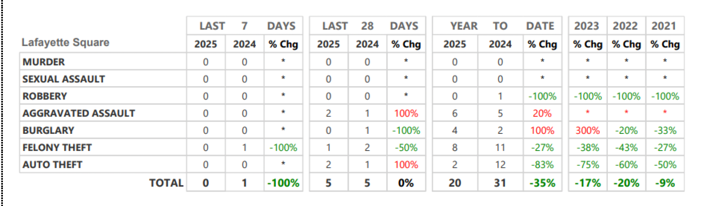
Neighborhood Crime and Activity Report
Lafayette Square
for 28 days ending May 11, 2025

Slide 12
St. Louis Neighborhood Stabilization Division
Neighborhood Improvement Specialist:
Ms. Reign Harris
harrisre@stlouis-mo.gov
(314) 901-3615 (cell)

Slide 13
Barr Branch, St. Louis Public Library
Branch Manager:
Roxxanne Reed
rreed@slpl.org
314‑241‑2288 x3086

Slide 14
Lafayette Park Conservancy (LPC)
Executive Director:
Michael Bushur
michael.bushur@lafayettepark.org
(314) 949-2210

Slide 15
Back to . . . Community Updates
8th Ward Board of Aldermen Candidates
Police Report: Officer Rosa Rojas
Neighborhood Improvement Specialist: Reign Harris
Barr Library: Roxxanne Reed
Lafayette Park Conservancy: Michael Bushur
Lafayette Square Neighborhood Yard Sale (Sat. May 31 9am-3pm)
Arts Council of Lafayette Square
LS Community Directory: 2025-2026
Lafayette Prep Academy
Lafayette Park United Methodist Church
City Church
St. Mary’s Assumption Church
A. T. Still University
Moms in the Square
LS Ladies Libation League (Next: Wed. 5/28, 6 pm @ 1111 Mississippi)

Slide 16
LS Community Directory: 2025-2026
Still time to use the QR code to enter info until June 1.
Final production files will be turned over to STL Programs before June 15th.
3. Printing finished by July 15th.
4. Distribution of directory to each resident by August 1. This date is flexible and there will be an update once more info is relayed.
5. Last year approximately 200 people used the Google form and approximately 300 used it this year.
6. Next year the QR code will be the only graphic. The long term plan is to persuade people to fill in the form because our data will be cleaner.

Slide 17
Officer and Chair Reports
    President: Vince Volpe
    Treasurer: Tom Murphy
    Membership Chair: Kim Winters
    Fundraising Chair: [Vacant]
    Communications Chair: Ben Warner
    Preservation Chair: Travis Gocken
    Safety Chair: Jeff Kirkpatrick
    Improvements Chair: Mitch Hunt
    Business Affairs: Bart Lissner

Slide 18
President’s Report:
Vince Volpe
president@lafayettesquare.org

Slide 19
Proposal for former Mack Truck site
2350 Chouteau (corner of Jefferson & Chouteau)
Re: Owner’s architectural plans to build a 24/7 public storage facility
Opposition to proposal based on two unanimous votes at 4/9/25 membership meeting and board email vote as of 4/15/25.
Sent 4/16/25 letter in opposition to 8 city officials – email & USPS: Cultural Resources, Zoning, LCRA, SLDC, Mayor Spencer, Reign Harris.
Prompt responses from Bob Bettis (Cultural Resources), Don Roe (SLDC) per phone call & 4/16/25 email; Mayor Spencer’s office (Dan Guenther); and Reign Harris.
Lisa Otke (SLDC Neighborhood Transformation Manager) was appointed coordinator & pollinator re all information on site & process.

Slide 20
Vicini Lease
Lessee: A New Dawn, Inc. (dba Vicini Pastaria)
  Owners: Dawn Wilson and Chutchat Kidkul
Lease for eastern half of “pocket park” (SE corner of Mississippi & Park Avenue)
Approved by board email vote as of 5/5/25
Use: restaurant and occasional special events
Lease is effective May 1, 2025 (or as soon as Vicini can secure a city permit for operating there)
Two Terms: May 1, 2025 through Aug. 31, 2025
and Apr. 1, 2026 through Oct. 31, 2025 (upon notice to Lessor)
Rent: $150 per month

Slide 21
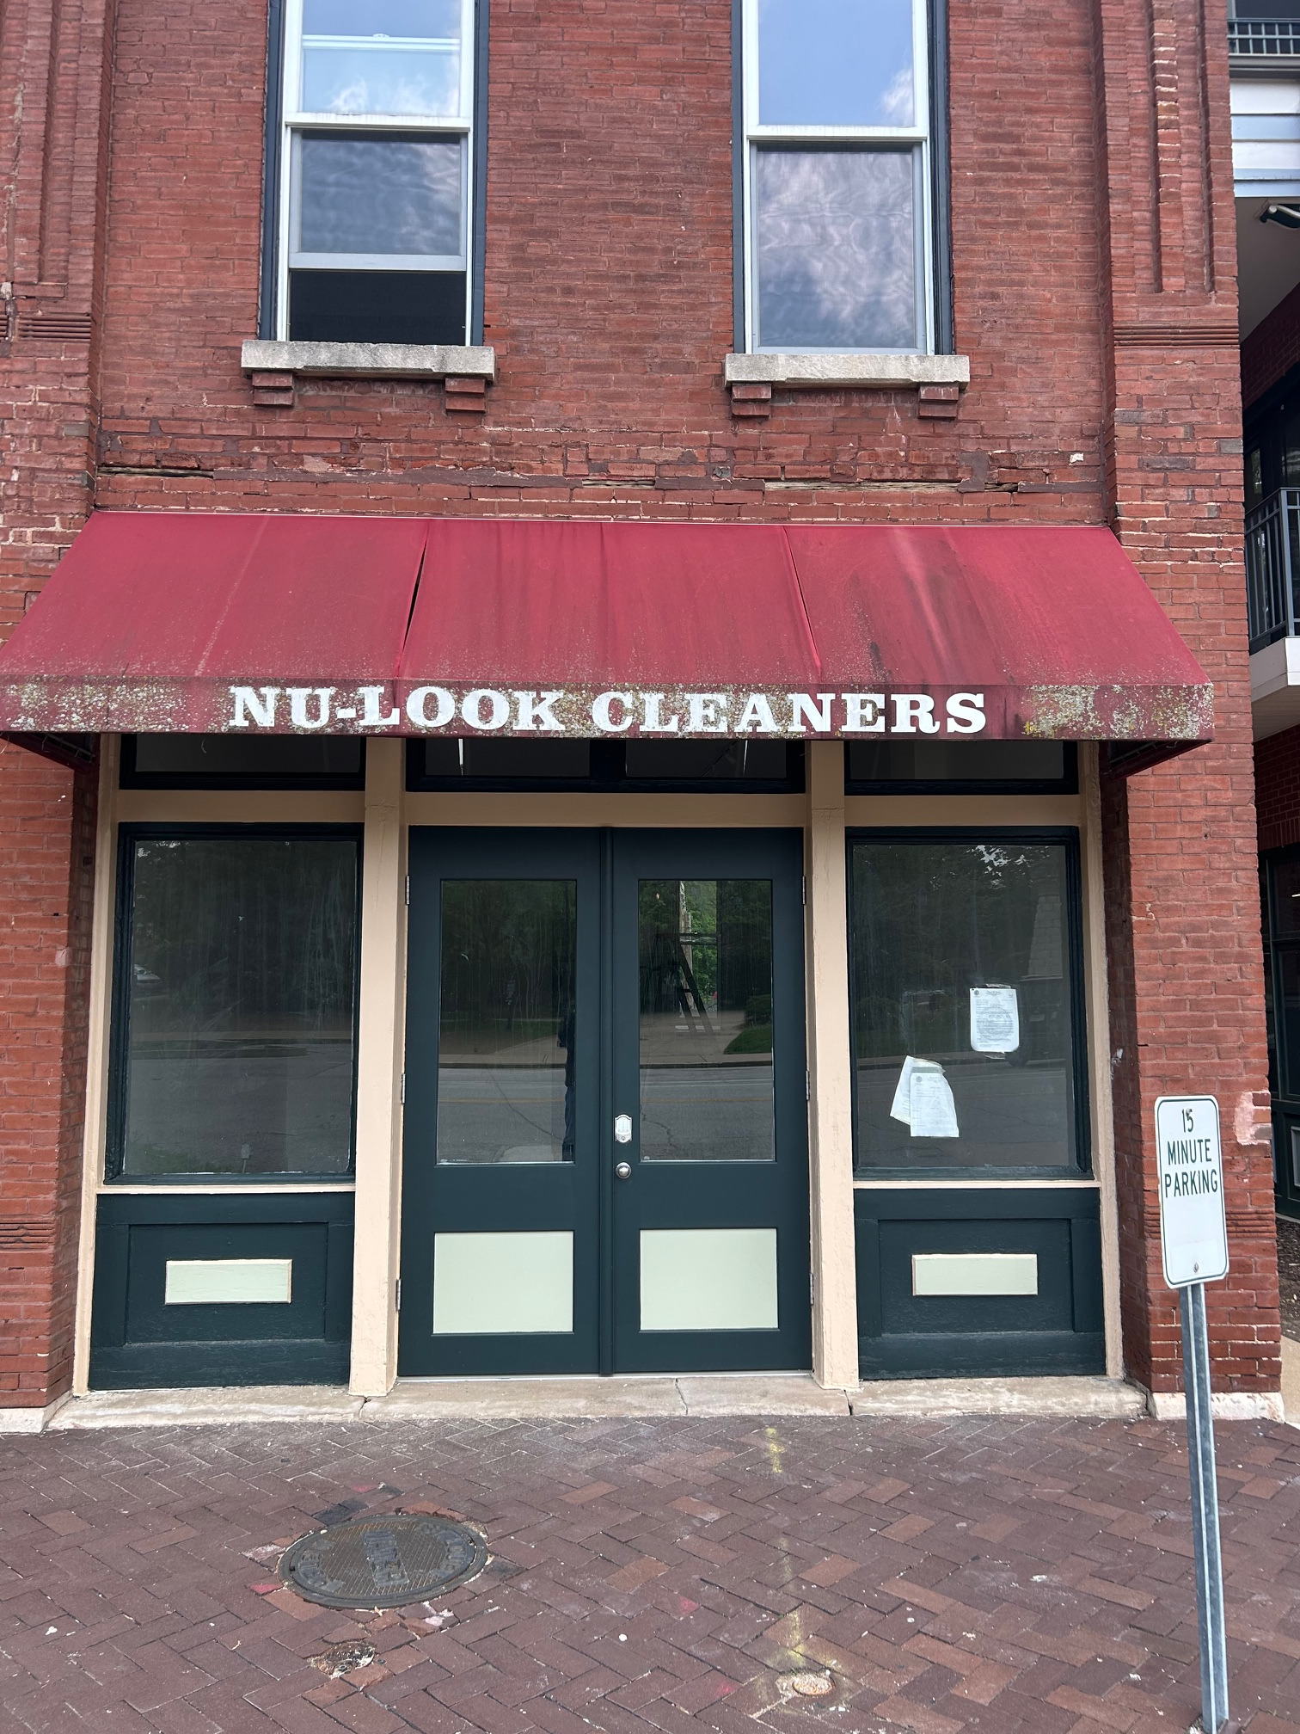
1817 Park Avenue Lease
Lessor: 1819 Park Avenue, LLC (Chris Greene)
Approved by email board vote as of 5/12/25
Lease is effective 5/14/25
3-year lease; 533 sf (first floor only)
Rent: $1,000 per month (+ elec., gas)
Uses:
        Police sub-station in business district
        Merchandise/ supplies storage
        Board and committee meetings
Replaces current police sub-station on Park Avenue
The $1.00 /year lease on the Park House to terminate in June

Slide 22
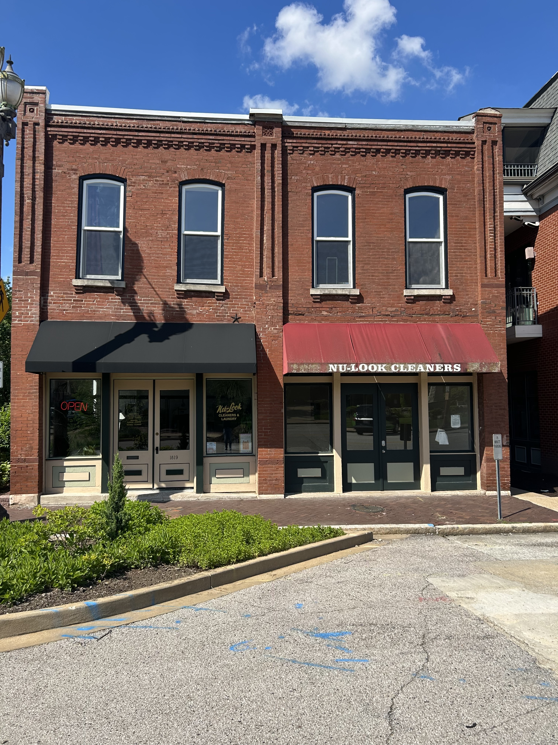
1817 Park Avenue Lease

Slide 23
Treasurer:
Tom Murphy
treasurer@lafayettesquare.org

Slide 24
Membership Chair:
Kim Winters
membership@lafayettesquare.org

Slide 25
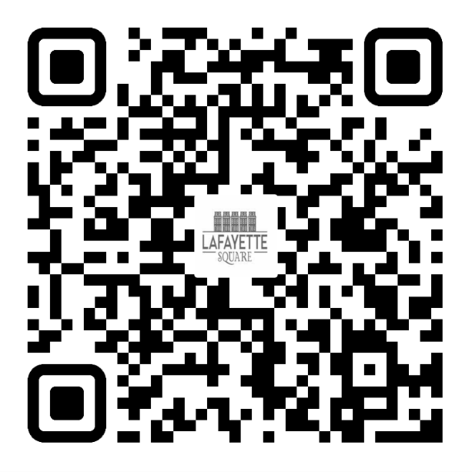
2025 LSNA MEMBERSHIP GOAL:
50 NEW MEMBERSHIPS (350 TOTAL) &
18% OF RESIDENTS ARE LSNA MEMBERS
APRIL: 308 MEMBERSHIPS / 14%
MAY: 303 MEMBERSHIPS / 14%
JOIN TODAY!
UNSURE IF YOU ARE A MEMBER OR
DO YOU HAVE QUESTIONS?
PLEASE EMAIL ME AT:
MEMBERSHIP@LAFAYETTESQUARE.ORG

Slide 26
Fundraising Chair:
[Vacant]
fundraising@lafayettesquare.org

Slide 27

WRONG !!!

Slide 28
Spring House & Garden Tour
Saturday, June 7 & Sunday, June 8, 2025
10:00 am to 5:00 pm
Sign-ups for docent and other volunteers [See next slide]
11 houses and 3 stand-alone gardens on tour
  Tour goers will see all four quadrants of the Square
Tour Book copy has been submitted
Posters, park gate banners, and yard signs are up
Carriages and Trolleys have been reserved
Post-Dispatch to do story with photos on a selected home
Tour dedication to Tom & Lynne Keay

Slide 29
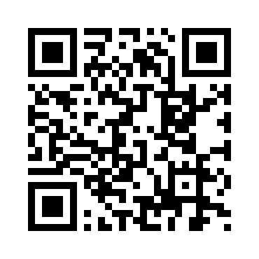
Spring House & Garden Tour
Sat., June 7 & Sun., June 8, 2025
10:00 am to 5:00 pm
Sign-up for docent and other volunteer slots >>>
Afterparty: 6:00 pm Sun. June 8th
@ SqWires Annex
(for homeowners, docents, volunteers)

Slide 30
Spring House & Garden Tour
Sat., June 7 & Sun., June 8, 2025
10:00 am to 5:00 pm
COMMITTEE:
Tickets – Kelly Schlueter (via OneCause) [See next slide]
Publicity – Jamie Winner
Social Media – Catherine Gilbert
Sponsorships – Michael Quinn
Homeowner Liaisons – Hannah Krigman & Jon Ritter
Spring Market – Kaeli Cutting
Communications – Ben Warner
Antique Fair – Kelly Schlueter
Volunteer Coordinator – Phil Lamcyzk (Ben Warner assisting)
Home Selection – Mike McAvoy

Slide 31
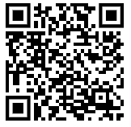
Spring House & Garden Tour
Sat., June 7 & Sun., June 8, 2025
10:00 am to 5:00 pm
Tickets: Via OneCause
$35 Member-Only Presale Tickets (w/ Promo discount code):
Available only thru Friday, 5/16
$40 General Sales Tickets: Ending Fri. 6/6
$50 Day-of Tickets on Sat. 6/7 and Sun. 6/8
See next slide for bigger QR code>>

Slide 32
Spring House & Garden Tour
Sat., June 7 & Sun., June 8, 2025
10:00 am to 5:00 pm
QR code for
ticket sales >>>
Promo Code for members $35 price: LS2025Tour

Slide 33
Communications Chair:
Ben Warner
communications@lafayettesquare.org

Slide 34
Website
  Why we’re getting a new website:
  Current issues: infrequent use, design limitations
  Improvement goals: loading time, sitemap layout
  New goals: Modernized design, mobile-friendly layout, better integration with other media.
Who's going to design it:
  Studio 2108 – Wayne White, Owner – LS resident since 1998
  Served over 100+ clients for over 10 years.
  Hosting through WP Engine.
  We’ve Budgeted up to $20k for redesign + $4,375 for hosting/updates
What will be involved:
  New design and implementation in 8-12 weeks.
  Interested in giving feedback? Email communications@lafayettesquare

Slide 35
COMMUNICATIONS
The Marquis: May issue was distributed May 9th.
      Submissions for Remaining 2025 issues due by:
      August 1st for August 22nd publication
      October 24th for November 14th publication

Slide 36
Preservation Chair:
Travis Gocken
preservation@lafayettesquare.org

Slide 37
Problem Properties:
Christina Ryan
problemproperties@lafayettesquare.org

Slide 38
Business Affairs Chair:
Bart Lissner
lsba@lafayettesquare.org

Slide 39
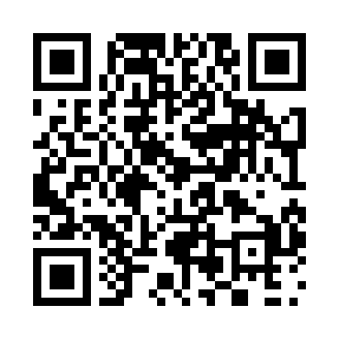
Cocktails on the Plaza
Wed. May 21st
5:15 pm to 7:15 pm
QR code for
Cocktails on the Plaza tickets>>>

Slide 40
Improvements Chair:
Mitch Hunt
improvements@lafayettesquare.org

Slide 41
Snow Removal/ Salting Proposal
for all streets and alleys
in the historic district
Currently: We rely on the City or our own last-minute arrangements by certain blocks
Idea was discussed by an ad hoc committee and presented to the board at the May 6th board meeting.
Proposal from Hank's Lawncare:
In business for 40+ years
$2M in insurance and is bonded
Equipment and labor hours per each 3” snow event:
4 trucks for snow plowing and salting
5 hours
$200 per truck per hour
Average cost for salting only: $1,000 @ only $100/ hour (we would already own the salt)
Up front costs:
$4,000 retainer for labor and trucks to be applied to a 3” snow event
$4,000 for salt (10 pallets of 48 50-lb. bags on each pallet) purchased and stored by Hank
Salt costs $2,000 more if purchased in winter
Salt remains ours. Stored by Hank until used up.

Slide 42
Snow Removal/ Salting Proposal
for all streets and alleys
in the historic district
    “Motion to authorize expenditure of up to $16,000 in the 2025 budget for a snow removal/ salting contract with a reputable contractor for all streets and alleys in the historic district to be spent as necessary during the winter of 2025-2026. The discussion of this motion and any vote thereon to be scheduled for the June 11th membership meeting."

Slide 43
Snow Removal/ Salting Proposal
Per Bylaws Article XI, paragraph 8:
“Any motion by a member or officer for appropriation of funds beyond what is approved by the budget to authorize spending in excess of $3,000 will require the motion to be taken at the current membership meeting and tabled.
Discussion of the motion may take place for a time period deemed appropriate by the membership and the president.
Voting to approve or deny the motion will take place at the following membership meeting after the motion has been presented to the board of directors at the next board meeting, and once the motion has been communicated to the members of the Association through publication of the motion (e.g., via an email to all members).”

Slide 44
Safety Chair:
Jeff Kirkpatrick
safety@lafayettesquare.org

Slide 45
Other Reports
Block Captains: Wayne White
Beautification: Linda Weiner

Slide 46
Block Captains:
Wayne White
wmw@studio2108.com
Next Block Captains Meeting:
Wednesday, June 11th 6:00 pm SqWires Annex

Slide 47
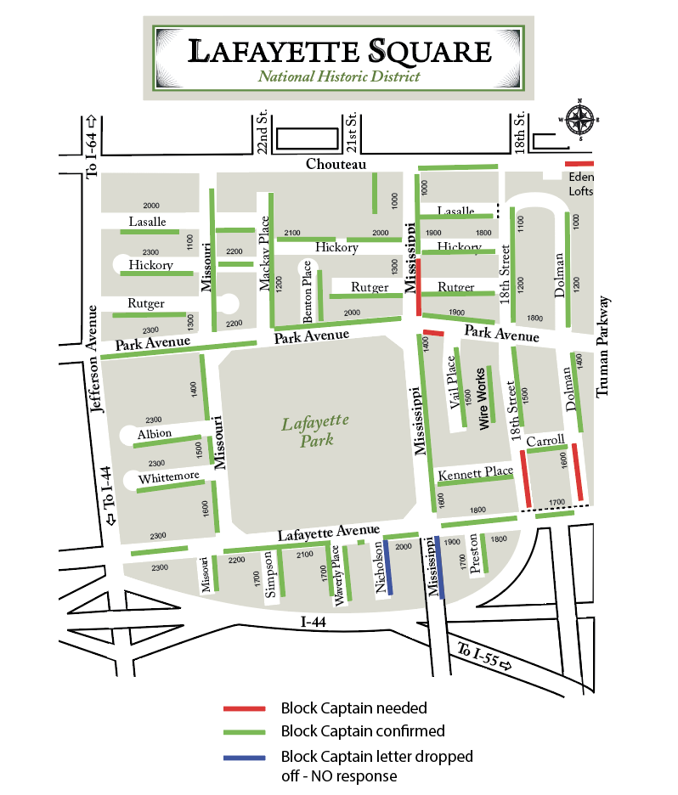

Slide 48
We need Block Captains for:
•1600 Dolman
•1700 Mississippi
•1700 Nicholson

Slide 49
Beautification:
Linda Weiner
linderweiner@gmail.com

Slide 50
Upcoming Events
Cocktails on the Plaza: Wed. May 21st 5:15 pm to 7:15 pm
Lafayette Square Neighborhood Yard Sale: Sat. May 31 9 am–3 pm
Board Meeting: 7:00 pm Tue. June 3rd
Spring House and Garden Tour (the “56th Annual”)
    Sat. June 7th & Sun. June 8th – 10:00 am to 5:00 pm
    First Concert in the Park: Sat. June 7th 6:00 pm
    Tour Afterparty: 6:00 pm: Sun. June 8th @ SqWires Annex
    Block Captains Mtg: 6:00 pm Wed. June 11th (SqWires Annex)
    General Meeting: 7:00 pm Wed. June 11th (SqWires Annex)
Tour de Lafayette: Friday, August 29th 1:30 pm to 10:30 pm
Light Up the Square/Pet Parade, Sat. December 6th
Holiday Parlor Tour (the ”48th Annual”): Sun. December 14th

Slide 51
Announcements
Before we adjourn: Any announcements?

Slide 52
Adjournment
Is there a motion to adjourn?
Is there a second?
We are adjourned.
Thank you.
TIME TO SOCIALIZE !!

