Slide 1

Membership Meeting
Wednesday
March 12, 2025
Lafayette Square Restoration Committee (LSRC)
The neighborhood association
of Lafayette Square
Established 1969.
Incorporated 1971.
dba Lafayette Square Neighborhood Association
(LSNA)
Since 2022

Slide 2
AGENDA
Call to order
Approval of March 12, 2025 minutes
Welcome new residents
Sharing of news
Guest Speakers & Community Updates
Officer and Committee Chair Reports
  President
  Treasurer
  Membership
  Fundraising/ Problem Properties
  Communications
  Preservation
  Safety
  Improvements
  Business Affairs
Other Reports
  Block Captains
  Beautification
Upcoming Events
Announcements
Adjournment
Post-Meeting Socializing

Slide 3
Approval of
March 12, 2025
Membership Meeting Minutes
Is there a motion to approve the February minutes?
Is there a second?
The minutes are approved.
Thank you.

Slide 4
New neighbors:
Welcome to our community!
Please introduce yourself.
Also . . . For anyone else . . .
Something to (briefly) share; but not overshare?
Birthday (significant or otherwise)?
Anniversary of something?
Significant life event?

Slide 5
Guest Speakers/ Community Updates
Alderwoman/ Mayor-Elect: Cara Spencer
Police Report: Officer Rosa Rojas
Neighborhood Improvement Specialist: Reign Harris
Barr Library: Roxxanne Reed
Lafayette Park Conservancy: Michael Bushur
City Church: Pastor Mike Werkheiser
Arts Council of Lafayette Square
LS Community Directory: 2025-2026: Donna Hagerty-Payne
Lafayette Prep Academy
Lafayette Park United Methodist Church
St. Mary’s Assumption Church
A. T. Still University
Moms in the Square
Lafayette Square Ladies Libation League (See LS Community FB page announcement)

Slide 6
8th Ward Alderwoman & Mayor-Elect
Cara Spencer
Office: (314) 622-3287‬
Mobile: ‭(314) 556-7379‬
spencerc@stlouis-mo.gov
‭

Slide 7
Police Report: Officer Rosa Rojas
314-444-2595
rrojas@slmpd.org

Slide 9
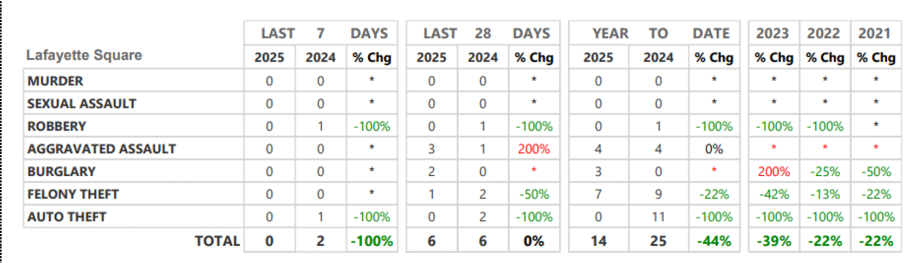

Slide 10
St. Louis Neighborhood Stabilization Division
Neighborhood Improvement Specialist:
Ms. Reign Harris
harrisre@stlouis-mo.gov
(314) 901-3615 (cell)

Slide 11
Barr Branch, St. Louis Public Library
Branch Manager:
Roxxanne Reed
rreed@slpl.org
314‑241‑2288 x3086

Slide 12
Lafayette Park Conservancy (LPC)
Executive Director:
Michael Bushur
michael.bushur@lafayettepark.org
(314) 949-2210

Slide 13
City Church
Pastor Mike Werkheiser
mike@citychurchstl.org
1908 Lafayette Ave

Slide 14
Back to . . . Community Updates
Alderwoman Cara Spencer
Police Report: Officer Rosa Rojas
Neighborhood Improvement Specialist: Reign Harris
Barr Library: Roxxanne Reed
Lafayette Park Conservancy: Michael Bushur
City Church: Pastor Mike Werkheiser
Arts Council of Lafayette Square
LS Community Directory: 2025-2026: Donna Hagerty-Payne
Lafayette Prep Academy
Lafayette Park United Methodist Church
St. Mary’s Assumption Church
A. T. Still University
Moms in the Square
Lafayette Square Ladies Libation League

Slide 15
Officer and Chair Reports
    President: Vince Volpe
    Treasurer: Tom Murphy
    Membership Chair: Kim Winters
    Fundraising Chair: [Vacant]
    Communications Chair: Ben Warner
    Preservation Chair: Travis Gocken
    Safety Chair: Jeff Kirkpatrick
    Improvements Chair: Mitch Hunt
    Business Affairs: Bart Lissner

Slide 16
President’s Report:
Vince Volpe
president@lafayettesquare.org

Slide 17
Treasurer:
Tom Murphy
treasurer@lafayettesquare.org

Slide 18
Membership Chair:
Kim Winters
membership@lafayettesquare.org

Slide 19
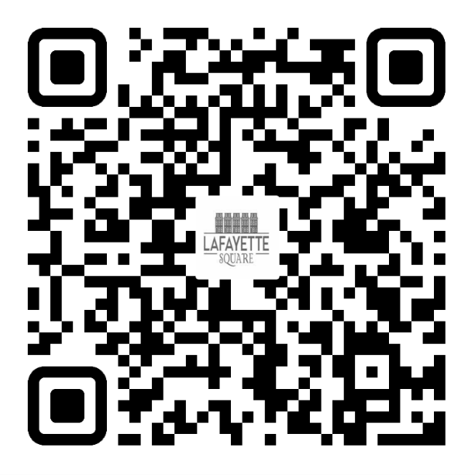
2025 LSNA MEMBERSHIP GOAL:
50 NEW MEMBERSHIPS (350 TOTAL) &
18% OF RESIDENTS ARE LSNA MEMBERS
FEBRUARY: 299 MEMBERSHIPS / 14%
MARCH: 304 MEMBERSHIPS / 14%
JOIN TODAY!
UNSURE IF YOU ARE A MEMBER OR
DO YOU HAVE QUESTIONS?
PLEASE EMAIL ME AT:
MEMBERSHIP@LAFAYETTESQUARE.ORG

Slide 20
Fundraising Chair:
[Vacant]
fundraising@lafayettesquare.org

Slide 21
Spring House & Garden Tour
Sat., June 7 & Sun., June 8, 2025
10:00 am to 5:00 pm
Homes & Gardens: Vince Volpe
Publicity: Jamie Winner
Sponsorships: Michael Quinn
Tickets: Kelly Schlueter (via OneCause) [See next slide]
Homeowner Liaisons: Hannah Krigman & Jon Ritter
Antique Fair: Kelly Schlueter
And . . . two trolleys & the horse-drawn carriage are booked for both days & Tour Book ad sales have begun (STL Programs)
Afterparty: 6:00 pm Sun. June 8th @ SqWires Annex
(for homeowners, docents, volunteers)

Slide 22
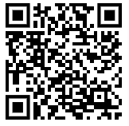
Spring House & Garden Tour
Sat., June 7 & Sun., June 8, 2025
10:00 am to 5:00 pm
Tickets: Via OneCause
$35 Member-Only Presale Tickets (w/ discount code):
Thu. 4/10 thru Fri. 4/18
$40 General Sales Tickets: Sat. 4/19 thru Fri. 6/6
$50 Day-of Tickets on Sat. 6/7 and Sun. 6/8
See next slide for bigger QR code>>

Slide 23
QR code for Tickets Sales to
Spring House & Garden Tour
Sat., June 7 & Sun., June 8, 2025
10:00 am to 5:00 pm

Slide 24
Communications Chair:
Ben Warner
communications@lafayettesquare.org

Slide 25
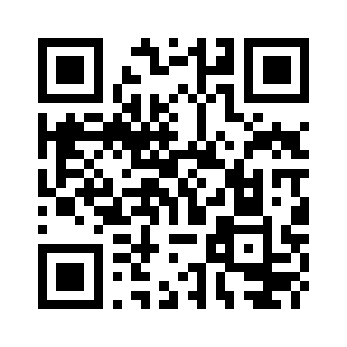
QR code for link to the Google Form for the website feedback survey.

Slide 26
COMMUNICATIONS
The Marquis: February issue was distributed Feb 14-16.
Remaining 2025 Issues:
      Submissions due by:
      April 18th for May 9th publication
      August 1st for August 22nd publication
      October 24th for November 14th publication

Slide 27
Preservation Chair:
Travis Gocken
preservation@lafayettesquare.org

Slide 28
Problem Properties:
Christina Ryan
problemproperties@lafayettesquare.org

Slide 29
Proposal for former Mack Truck site
2350 Chouteau
(corner of Jefferson & Chouteau)
The owner has developed architectural plans to build
a 24/7 public storage facility

Slide 30
Safety Chair:
Jeff Kirkpatrick
safety@lafayettesquare.org

Slide 31
Business Affairs Chair:
Bart Lissner
lsba@lafayettesquare.org

Slide 32
Improvements Chair:
Mitch Hunt
improvements@lafayettesquare.org

Slide 33
Other Reports
Block Captains: Wayne White
Problem Properties: Christina Ryan
Beautification: Linda Weiner

Slide 34
Block Captains:
Wayne White
wmw@studio2108.com

Slide 35
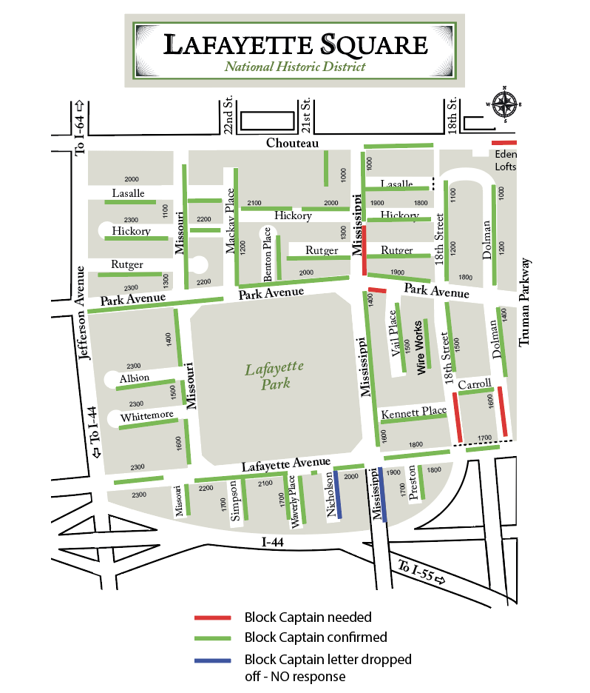

Slide 36
We need Block Captains for:
•1600 Dolman
•2050 - 2056 Lafayette (2 condo buildings)
•1700 Mississippi
•1100 - 1300 Missouri
•1700 Nicholson

Slide 37
Beautification:
Linda Weiner
linderweiner@gmail.com

Slide 38
Upcoming Events
Easter Egg Hunt: 10:00 am Easter Saturday, April 19th
(in the park by the playground)
Board Meeting: 7:00 pm Tue. May 6th
General Meeting: 7:00 pm Wed. May 14th (SqWires Annex)
Cocktails on the Plaza: Wed. May 21st 5 pm to 7:30 pm
Spring House and Garden Tour (the “56th Annual”)
    Sat. June 7th & Sun. June 8th 10:00 am to 5:00 pm
    First Concert in the Park: Sat. June 7th 6:00 pm
    Block Captains Mtg: 6:00 pm Wed. June 11th (SqWires Annex)
Tour de Lafayette: Friday, August 29th 1:30 pm to 10:30 pm
Light Up the Square/Pet Parade, Sat. December 6th
Holiday Parlor Tour: Sun. December 14th (the ”48th Annual”)

Slide 39
Announcements
Before we adjourn: Any announcements?

Slide 40
Adjournment
Is there a motion to adjourn?
Is there a second?
We are adjourned.
Thank you.
TIME TO SOCIALIZE !!

