Slide 1
Lafayette Square Neighborhood Association
Membership Meeting
December 2024

Slide 2
AGENDA
Call to order
Welcome new residents
Approval of October minutes
Guest Speakers
Alderwoman Cara Spencer
Police report
Barr Branch Library
Lafayette Park Conservancy
Neighborhood Stabilization Division
Lafayette Square Arts Council
New / Ongoing business
Block Captains update
Problem Properties update
Holiday House Tour
Committee Chair Reports
Treasurer
Business Affairs
Fundraising
Membership
Preservation
Communications
Safety
Improvements / Maintenance
Beautification
Announcements
Upcoming volunteer opportunities
Adjourn

Slide 3
Welcome to our new neighbors!

Slide 4
November 2024 minutes

Slide 5
Guest Speaker
Alderwoman Cara Spencer

Slide 6
Guest Speaker
Police Report
Officer Rojas

Slide 7
Guest Speaker
Barr Branch Library

Slide 8
Guest Speaker
Lafayette Park Conservancy
Mr. Michael Bushur

Slide 9
Guest Speaker
St. Louis Development Corporation
Neighborhood Manager
Ms. Lisa Otke

Slide 10
Guest Speaker
St. Louis Neighborhood Stabilization Division
Neighborhood Improvement Specialist
Ms. Reign Harris

Slide 11
Guest Speaker
Arts Council of Lafayette Square

Slide 12
Ongoing Business
Block Captains Update
Mr. Wayne White

Slide 13
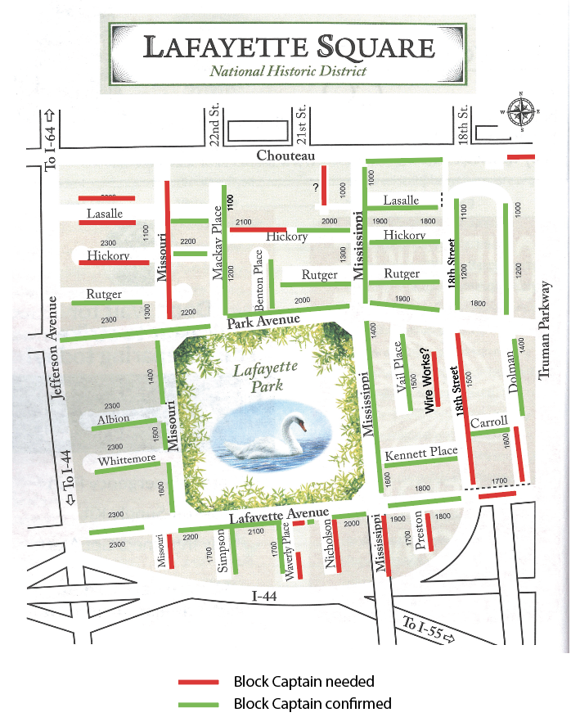

Slide 14
Block Captains
We need Block Captains for:
1600 Dolman
2000-2100 Hickory
2300 Hickory
1600 Lafayette
2050-2056 Lafayette (2 condo buildings)
1200-1300 Mississippi
1600-1700 Mississippi
1700 Missouri
1700 Preston

Slide 15
Ongoing Business
Problem Properties Update
Mr. Jassen Johnson

Slide 16
Ongoing Business
Holiday House Tour
Mrs. Bev Murphy

Slide 17
Chair Reports
Treasurer- Tom Murphy
Business Affairs- Bart Lissner
Fundraising- Jill Peckinpaugh
Membership- Kim Winters
Preservation- Marsha Delcour
Communications- Tim Strickfaden
Safety- George Boulware
Improvements / Maintenance- Mitch Hunt / Matt Negri
Beautification- Linda Weiner

Slide 18
Announcements
Holiday House Tour

Slide 19
Upcoming Events
Board Meeting: 1900 Tuesday 07 January (Park House)
General Meeting: 1900 Wednesday 08 January (SqWires Annex)
Holiday House Tour: 15 December

Slide 20
Upcoming Volunteer Opportunities
Light Up the Square Committee
fundraising@lafayettesquare.org
Holiday House Tour Committee
fundraising@lafayettesquare.org
Holiday House Tour Home
fundraising@lafayettesquare.org

