Slide 1
PROJECT OVERVIEW

Slide 2
What is the Purpose for the Project?
Provide new equitable access to growing and established job centers for residents with limited transportation options
Invest in historically underserved or marginalized neighborhoods
Expand and strengthen the region’s transportation network for future economic growth

Slide 3
Project History
Northside-Southside alignment created. Travels along Jefferson Ave. through downtown from Goodfellow/I-70 on the north to I-55/ Bayless Ave. on the south.
Alignment modified to accommodate existing development and future NGA West Campus. Proposed alignment extended from Grand Blvd. and Natural Bridge Ave. on north, south along Jefferson Ave. to Chippewa Ave.
2008
2018
2017
2023
City voters approved ½ cent sales tax for north-south light rail extension.
15% Design. Alignment modified due to COVID, growth in midtown, Downtown West and South City and equity focus. Resulted in 10 stations with three design options.

Slide 4
2024 Update
East-West Gateway Council of Governments, St. Louis’ metropolitan planning organization, adopts modified Northside-Southside Alignment as locally preferred alternative (LPA) on February 20
Citizens for Modern Transit endorse LPA with resolution March 7
Northside-Southside alignment renamed St. Louis MetroLink Green Line
Project moves to Environmental Review and 30% Design

Slide 5
PROJECT ALTERNATIVES

Slide 6
What is Being Studied
No Build Alternative
Keep existing transportation system as is except for already planned and committed transportation improvements.
Build Alternative
Approved as Locally Preferred Alternative
5.6 miles
10 station stops with three design options (reduces construction costs and property impacts)
New transfer station connecting to existing Red & Blue MetroLink lines

Slide 7
Build Alternative Features Modern In-Street Technology
Minimizes impacts to adjacent properties
Operates in dedicated lane, separated by curb to enhance safety and travel times
Enhances pedestrian experience with street level station boarding

Slide 8
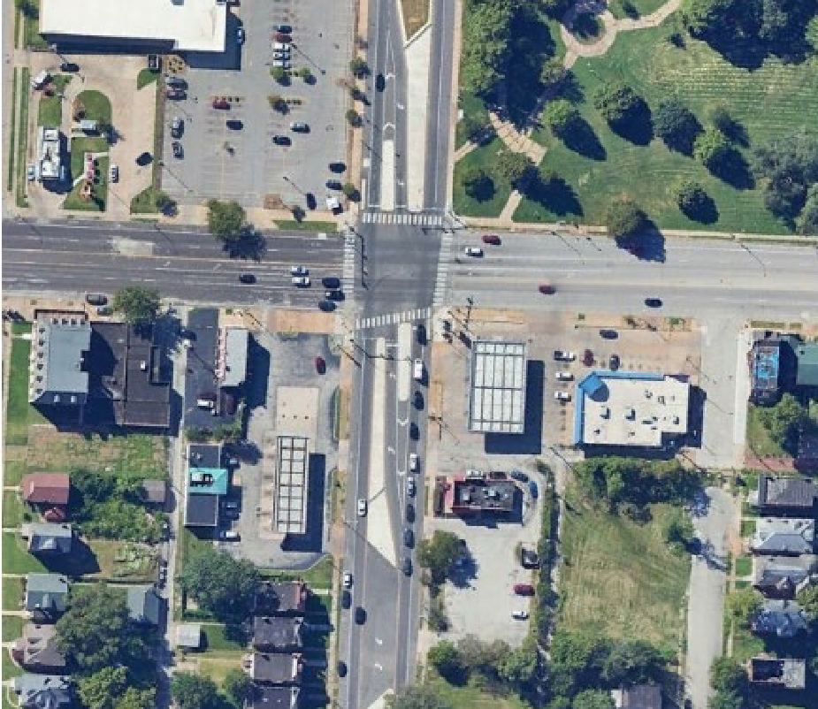
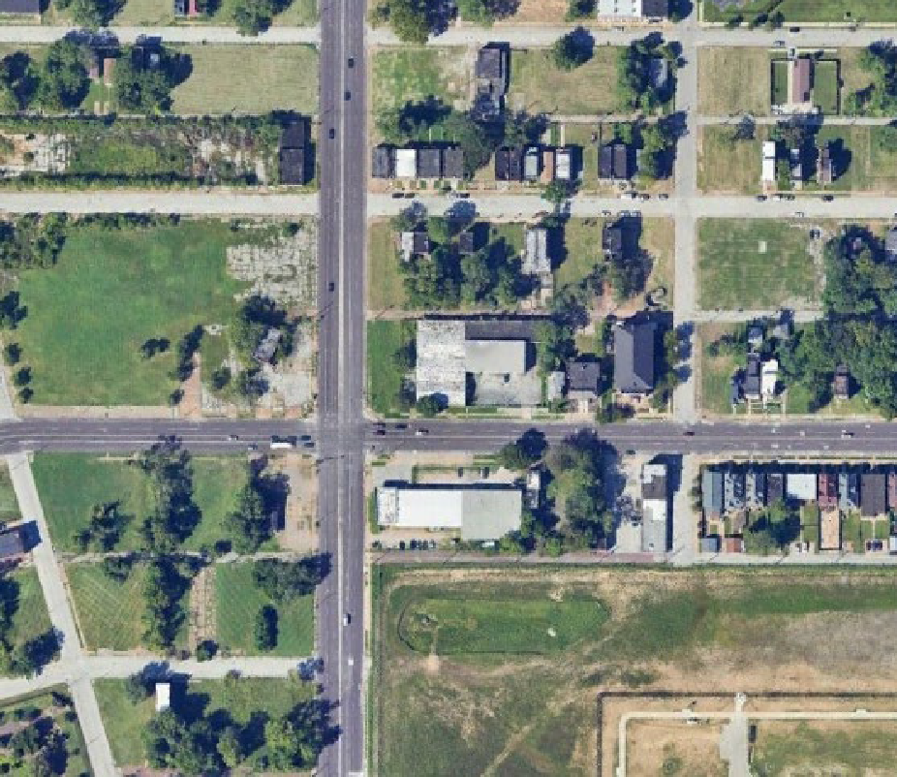
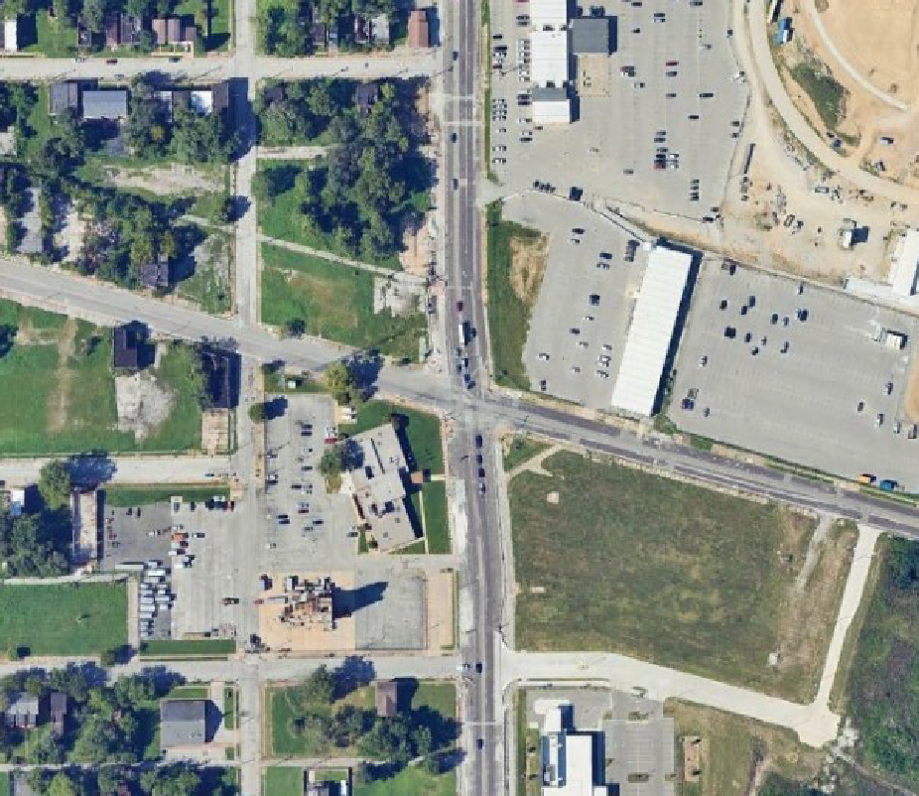
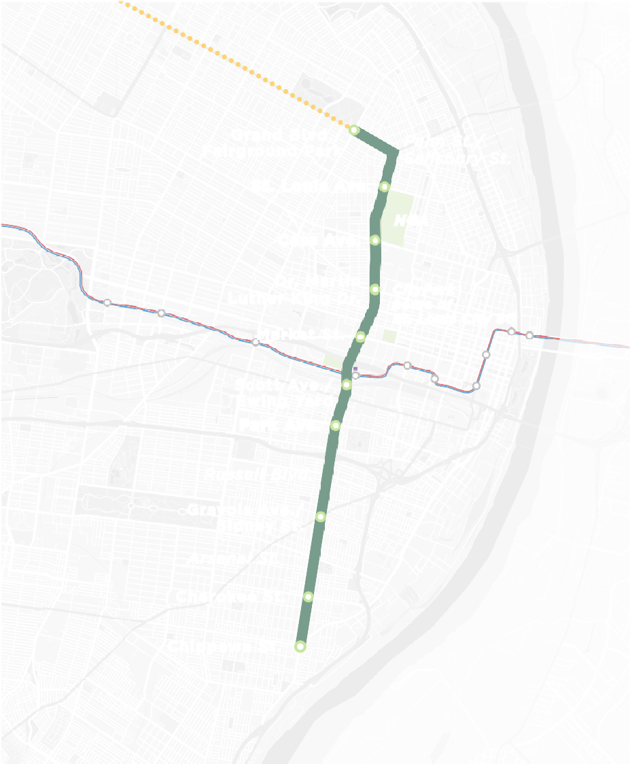
MetroLinkGreenLine.com
NATURAL BRIDGE AVE

NATURAL BRIDGE AVE

NATURAL BRIDGE AVE

70
N
Not to Scale
70
N
Not to Scale
70
N
Not to Scale
Grand Blvd./ Fairground Park
Palm St./
Salisbury St.
Grand Blvd./ Fairground Park
Palm St./
Salisbury St.
Grand Blvd./ Fairground Park
Palm St./
Salisbury St.
St. Louis Ave.
NGA
St. Louis Ave.
NGA
St. Louis Ave.
NGA
Cass Ave.
Dr. Martin Luther King Dr.
Cass Ave.
Dr. Martin Luther King Dr.
Cass Ave.
Dr. Martin Luther King Dr.
FOREST PARK
FOREST PARK AVE
CityPark home of
St. Louis City SC
FOREST PARK
FOREST PARK AVE
CityPark home of
St. Louis City SC
FOREST PARK
FOREST PARK AVE
CityPark home of
St. Louis City SC
64
Market St.
Transfer Station
MetroLink to IL
64
Market St.
Transfer Station
MetroLink to IL
64
Market St.
Transfer Station
MetroLink to IL
^{Scott A}ve./Ewing Yard
^{Scott A}ve./Ewing Yard
^{Scott A}ve./Ewing Yard
Scott Ave./ Ewing Yard
Park Ave.
Russell Blvd.
Scott Ave./ Ewing Yard
Park Ave.
Russell Blvd.
Scott Ave./ Ewing Yard
Park Ave.
Russell Blvd.
44
44
44
KINGSHIGHWAY BLVD
Gravois Ave./ Sidney St.
Arsenal St.
Cherokee St.
KINGSHIGHWAY BLVD
Gravois Ave./ Sidney St.
Arsenal St.
Cherokee St.
KINGSHIGHWAY BLVD
Gravois Ave./ Sidney St.
Arsenal St.
Cherokee St.
JEFFERSON AVE
JEFFERSON AVE
JEFFERSON AVE
Chippewa St.
55
Chippewa St.
55
Chippewa St.
55
GRAVOIS AVE
LEGEND
MetroLink Green Line Station Future Design Options
St. Louis MetroLink Green Line Alignment Future Extension Alternatives
Existing MetroLink
GRAVOIS AVE
LEGEND
MetroLink Green Line Station Future Design Options
St. Louis MetroLink Green Line Alignment Future Extension Alternatives
Existing MetroLink
GRAVOIS AVE
LEGEND
MetroLink Green Line Station Future Design Options
St. Louis MetroLink Green Line Alignment Future Extension Alternatives
Existing MetroLink
MISSOURI
ILLINOIS
MISSOURI
ILLINOIS
MISSOURI
ILLINOIS
Provides direct access to Fairground Park.
Station will make a direct connection to the Brickline Greenway along Grand Blvd.
Creates transportation node at the northern end of the NGA Campus
Station will make a direct connection to the Brickline Greenway
Provides an efficient gateway connection to the Next NGA West Campus.
Significant amounts of developable acreage directly adjacent to Cass Ave. Station.
Escanea el código QR

Slide 9
MLK Dr. Station – Consolidated Station
Washington Ave. and Carr St. Stations consolidated into one single station at Dr. Martin Luther King Dr.:
Minimizes impacts on schools, social service agencies, businesses, plus requires less right-of-way
Remains close to over 90% of population and jobs within 1/2-mile of two consolidated stations
Allows for more efficient use of resources and infrastructure

Slide 10
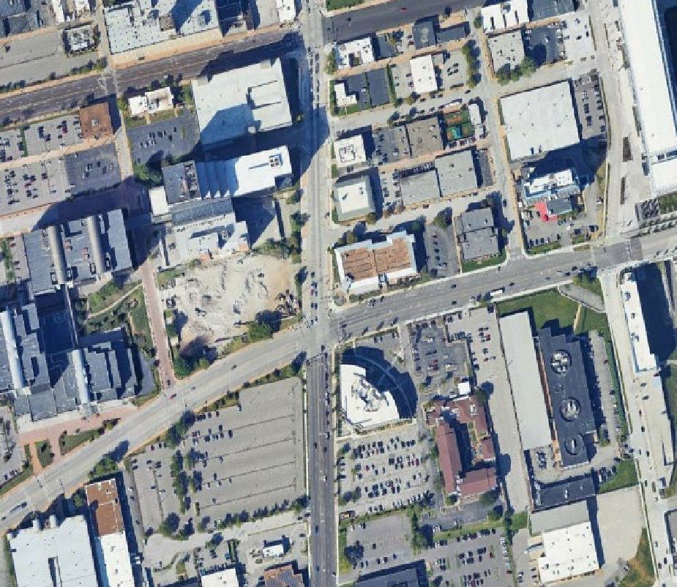
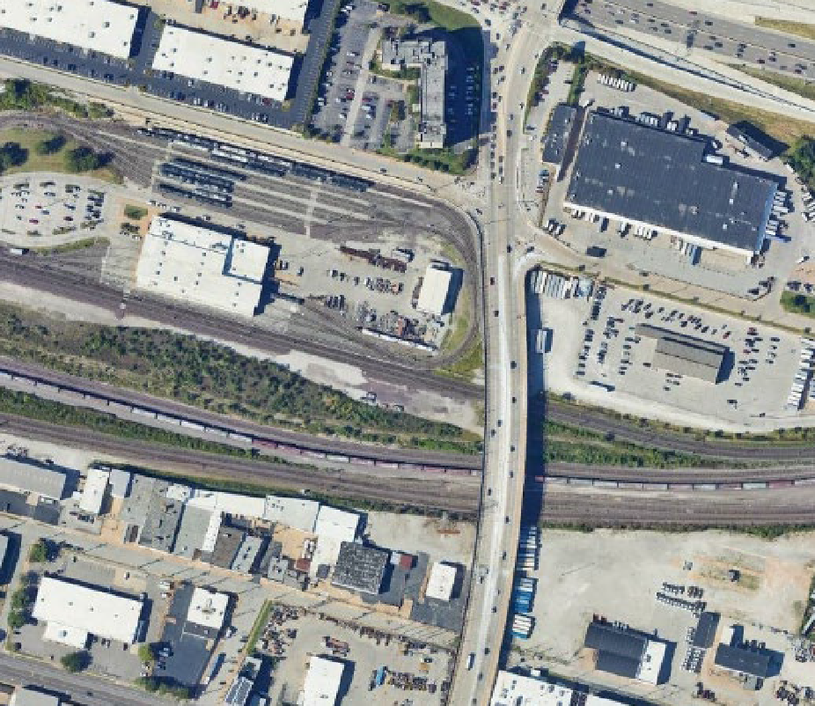
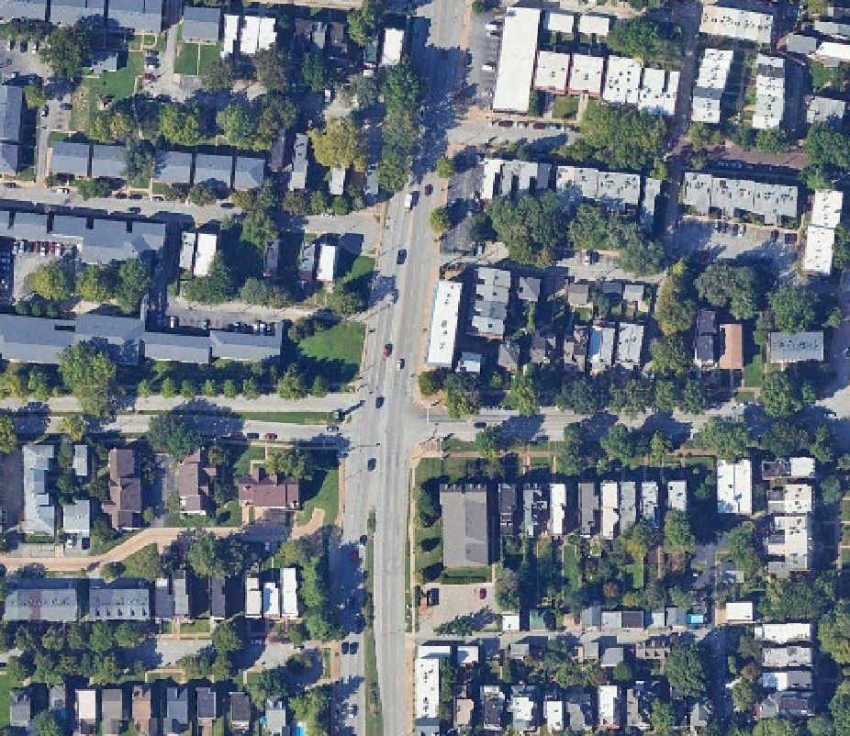
MetroLinkGreenLine.com
NATURAL BRIDGE AVE

NATURAL BRIDGE AVE

NATURAL BRIDGE AVE

70
N
Not to Scale
70
N
Not to Scale
70
N
Not to Scale
Grand Blvd./ Fairground Park
Palm St./
Salisbury St.
Grand Blvd./ Fairground Park
Palm St./
Salisbury St.
Grand Blvd./ Fairground Park
Palm St./
Salisbury St.
St. Louis Ave.
NGA
St. Louis Ave.
NGA
St. Louis Ave.
NGA
Cass Ave.
Dr. Martin Luther King Dr.
Cass Ave.
Dr. Martin Luther King Dr.
Cass Ave.
Dr. Martin Luther King Dr.
FOREST PARK
FOREST PARK AVE
CityPark home of
St. Louis City SC
FOREST PARK
FOREST PARK AVE
CityPark home of
St. Louis City SC
FOREST PARK
FOREST PARK AVE
CityPark home of
St. Louis City SC
64
Market St.
Transfer Station
MetroLink to IL
64
Market St.
Transfer Station
MetroLink to IL
64
Market St.
Transfer Station
MetroLink to IL
^{Scott A}ve./Ewing Yard
^{Scott A}ve./Ewing Yard
^{Scott A}ve./Ewing Yard
Scott Ave./ Ewing Yard
Park Ave.
Russell Blvd.
Scott Ave./ Ewing Yard
Park Ave.
Russell Blvd.
Scott Ave./ Ewing Yard
Park Ave.
Russell Blvd.
44
44
44
KINGSHIGHWAY BLVD
Gravois Ave./ Sidney St.
Arsenal St.
Cherokee St.
KINGSHIGHWAY BLVD
Gravois Ave./ Sidney St.
Arsenal St.
Cherokee St.
KINGSHIGHWAY BLVD
Gravois Ave./ Sidney St.
Arsenal St.
Cherokee St.
JEFFERSON AVE
JEFFERSON AVE
JEFFERSON AVE
Chippewa St.
55
Chippewa St.
55
Chippewa St.
55
GRAVOIS AVE
LEGEND
MetroLink Green Line Station Future Design Options
St. Louis MetroLink Green Line Alignment Future Extension Alternatives
Existing MetroLink
GRAVOIS AVE
LEGEND
MetroLink Green Line Station Future Design Options
St. Louis MetroLink Green Line Alignment Future Extension Alternatives
Existing MetroLink
GRAVOIS AVE
LEGEND
MetroLink Green Line Station Future Design Options
St. Louis MetroLink Green Line Alignment Future Extension Alternatives
Existing MetroLink
MISSOURI
ILLINOIS
MISSOURI
ILLINOIS
MISSOURI
ILLINOIS
Serves the extensive development that has occurred
Establishes a Light Rail Transit node in the heart of the Downtown West Neighborhood.
Connects the Green Line with the existing MetroLink system.
Station will provide access to the enlarged Vehicle Maintenance Facility.
Provides direct connection to Lafayette Park and the Lafayette Park Business District along Park Ave.
Provides a transit hub to dense residential neighborhoods.
Escanea el código QR

Slide 11
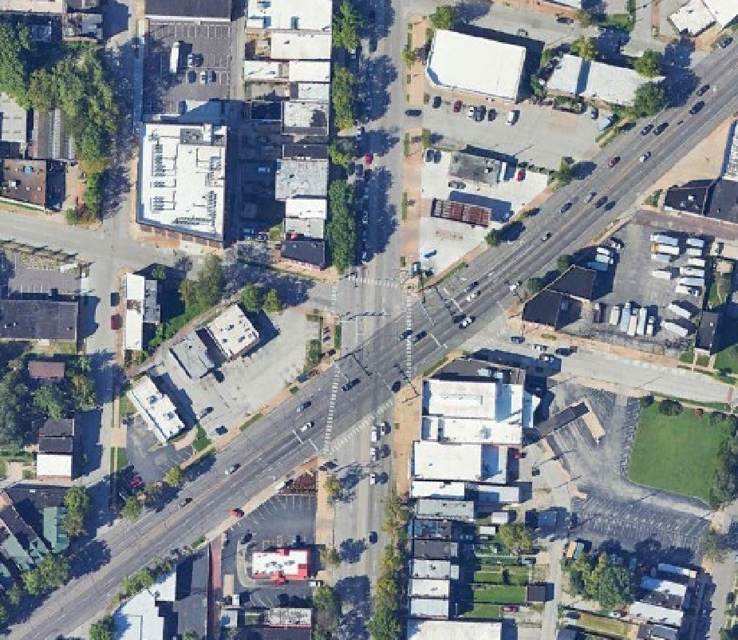
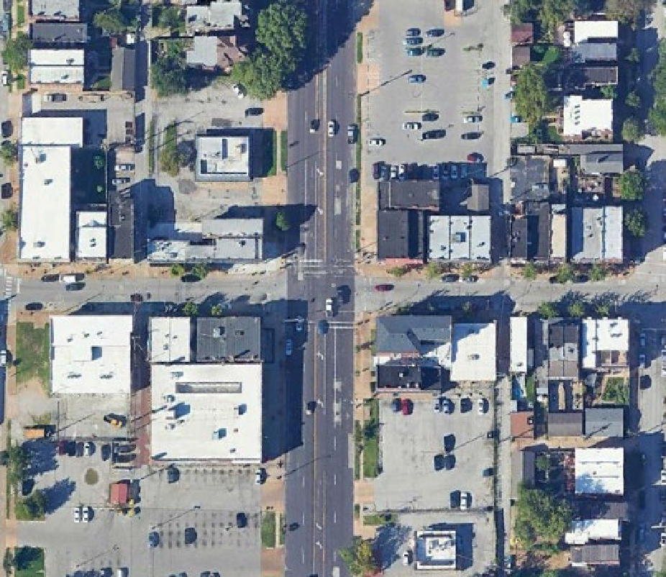
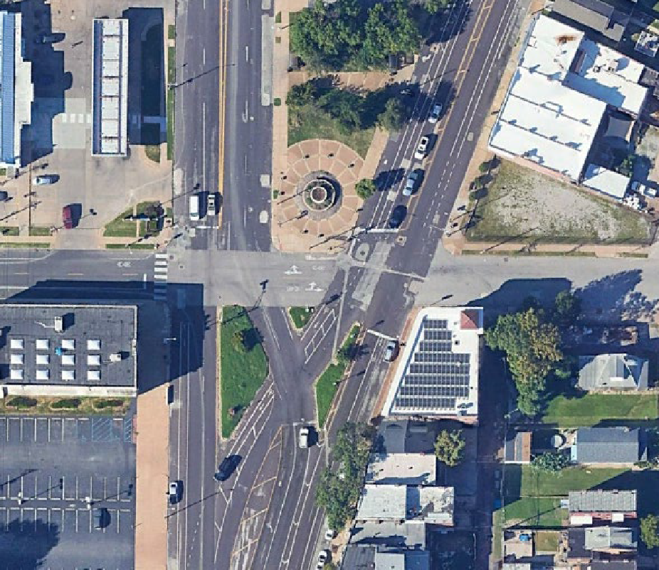
MetroLinkGreenLine.com
NATURAL BRIDGE AVE

NATURAL BRIDGE AVE

NATURAL BRIDGE AVE

70
N
Not to Scale
70
N
Not to Scale
70
N
Not to Scale
Grand Blvd./ Fairground Park
Palm St./
Salisbury St.
Grand Blvd./ Fairground Park
Palm St./
Salisbury St.
Grand Blvd./ Fairground Park
Palm St./
Salisbury St.
St. Louis Ave.
NGA
St. Louis Ave.
NGA
St. Louis Ave.
NGA
Cass Ave.
Dr. Martin Luther King Dr.
Cass Ave.
Dr. Martin Luther King Dr.
Cass Ave.
Dr. Martin Luther King Dr.
FOREST PARK
FOREST PARK AVE
CityPark home of
St. Louis City SC
FOREST PARK
FOREST PARK AVE
CityPark home of
St. Louis City SC
FOREST PARK
FOREST PARK AVE
CityPark home of
St. Louis City SC
64
Market St.
Transfer Station
MetroLink to IL
64
Market St.
Transfer Station
MetroLink to IL
64
Market St.
Transfer Station
MetroLink to IL
^{Scott A}ve./Ewing Yard
^{Scott A}ve./Ewing Yard
^{Scott A}ve./Ewing Yard
Scott Ave./ Ewing Yard
Park Ave.
Russell Blvd.
Scott Ave./ Ewing Yard
Park Ave.
Russell Blvd.
Scott Ave./ Ewing Yard
Park Ave.
Russell Blvd.
44
44
44
KINGSHIGHWAY BLVD
Gravois Ave./ Sidney St.
Arsenal St.
Cherokee St.
KINGSHIGHWAY BLVD
Gravois Ave./ Sidney St.
Arsenal St.
Cherokee St.
KINGSHIGHWAY BLVD
Gravois Ave./ Sidney St.
Arsenal St.
Cherokee St.
JEFFERSON AVE
JEFFERSON AVE
JEFFERSON AVE
Chippewa St.
55
Chippewa St.
55
Chippewa St.
55
GRAVOIS AVE
LEGEND
MetroLink Green Line Station Future Design Options
St. Louis MetroLink Green Line Alignment Future Extension Alternatives
Existing MetroLink
GRAVOIS AVE
LEGEND
MetroLink Green Line Station Future Design Options
St. Louis MetroLink Green Line Alignment Future Extension Alternatives
Existing MetroLink
GRAVOIS AVE
LEGEND
MetroLink Green Line Station Future Design Options
St. Louis MetroLink Green Line Alignment Future Extension Alternatives
Existing MetroLink
MISSOURI
ILLINOIS
MISSOURI
ILLINOIS
MISSOURI
ILLINOIS
Creates transportation hub along Gravois Ave., a major commercial arterial.
Establishes a Light Rail Transit connection to the Cherokee St. business district.
Provides a transit hub to dense residential neighborhoods.
Southern-most stop along the Green Line/Southern extension of Jefferson Ave.
Provides a transit hub to dense residential neighborhoods.
Escanea el código QR

Slide 12
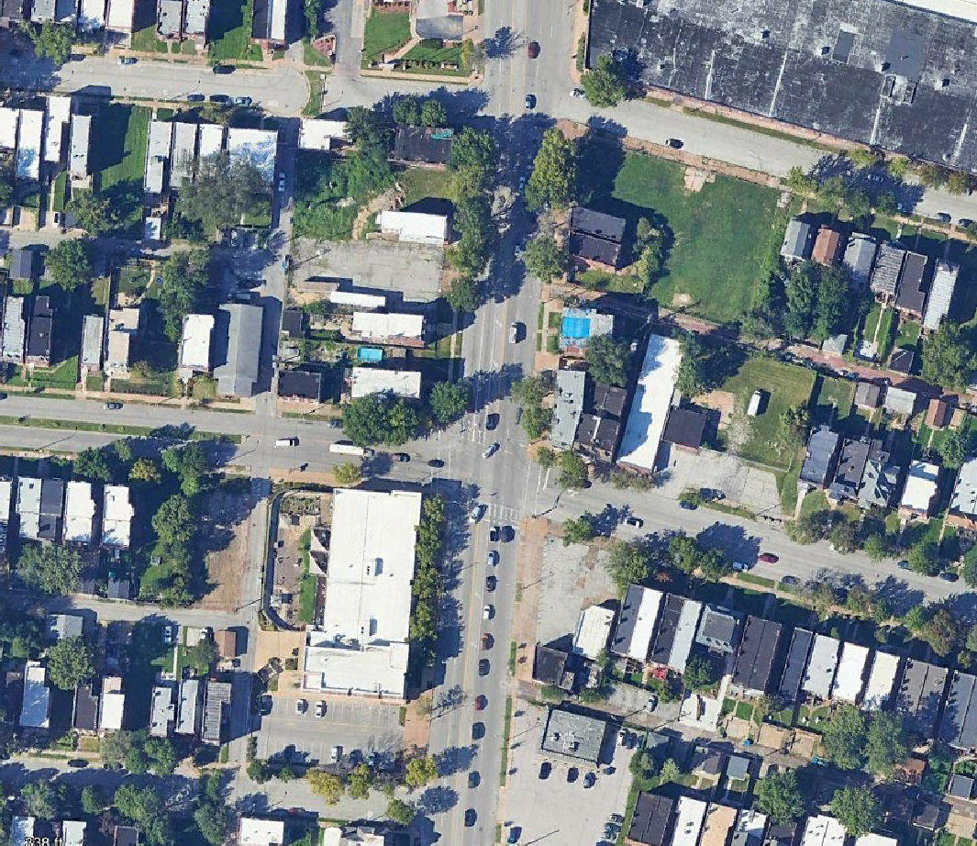
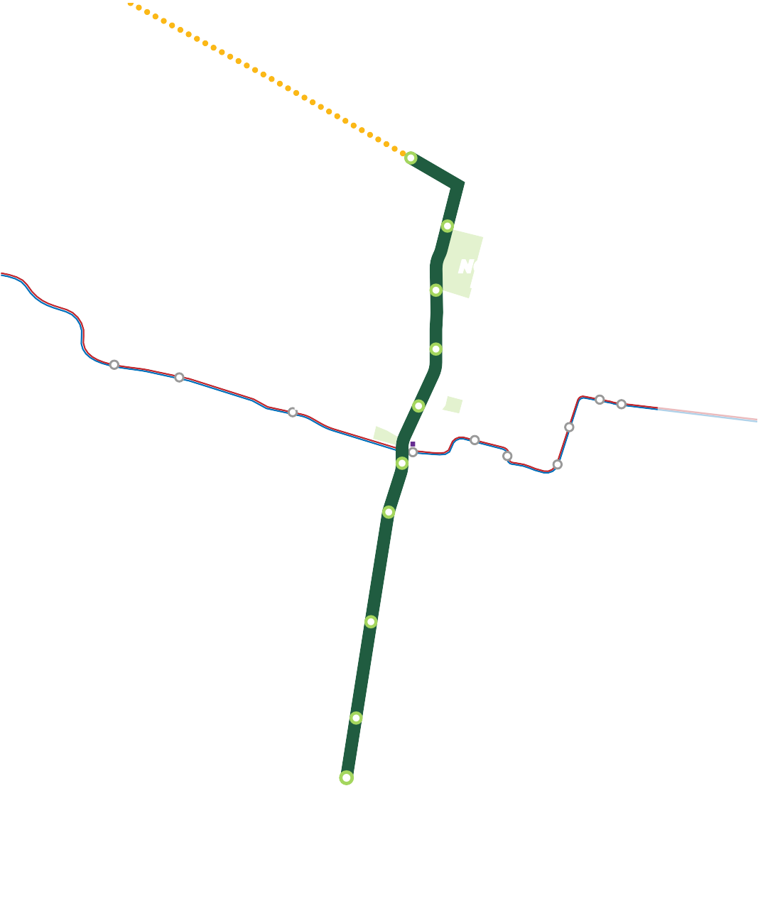
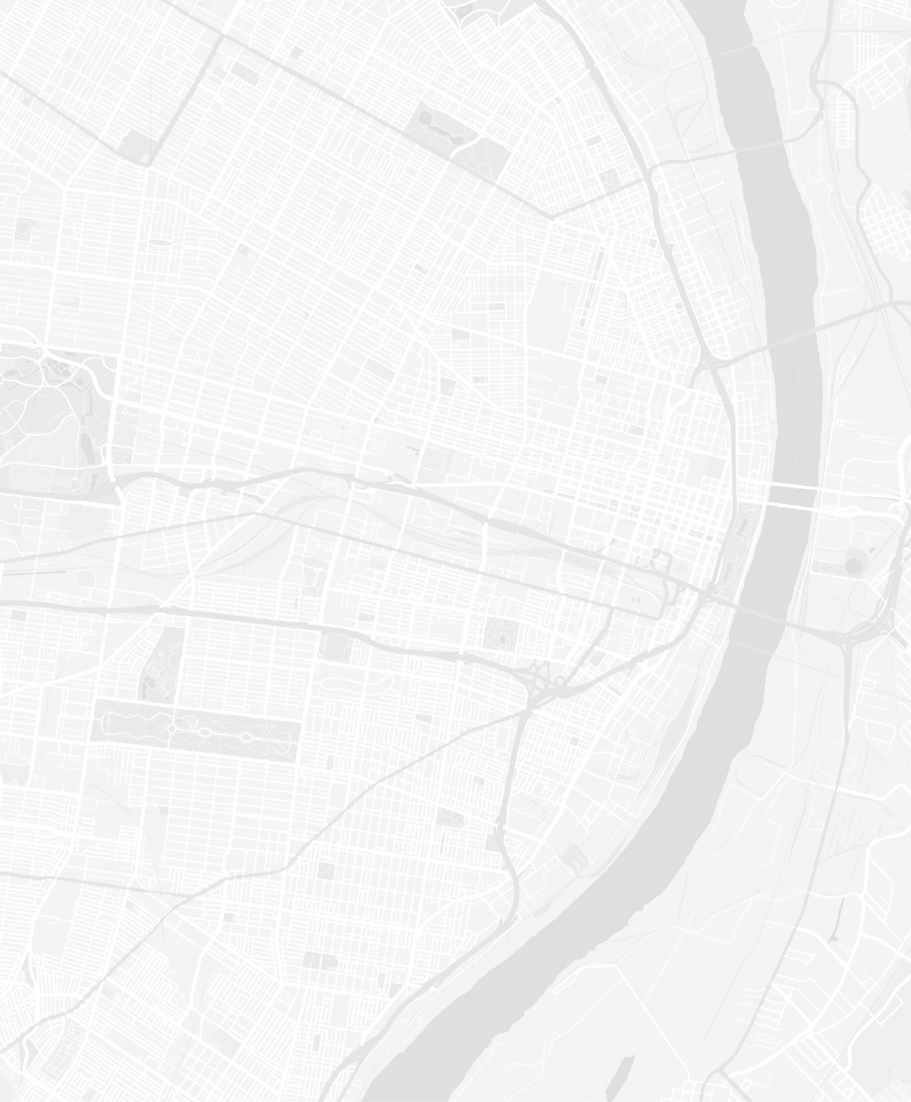
Design Options
MetroLinkGreenLine.com
Palm St./Salisbury St., Russell Blvd., and Arsenal St.:
Avoids potential building, business, and property impacts
NATURAL BRIDGE AVE

Remaining stations provide consistent neighborhood connectivity and access to proposed investments such as the Brickline Greenway
70
N
Not to Scale
Grand Blvd./ Fairground Park
St. Louis Ave.
Palm St./
Salisbury St.
Cass Ave.
Dr. Martin Luther King Dr.
NGA
FOREST PARK
FOREST PARK AVE
CityPark home of
St. Louis City SC
64
Market St.
Transfer Station
MetroLink to IL
^{S}cott Ave./Ewing Yard
Scott Ave./ Ewing Yard
Park Ave.
Russell Blvd.
44
KINGSHIGHWAY BLVD
Gravois Ave./ Sidney St.
Arsenal St.
Cherokee St.
55
JEFFERSON AVE
Maintains station spacing to under a mile
GRAVOIS AVE
Chippewa St.
LEGEND
MetroLink Green Line Station Future Design Options
St. Louis MetroLink Green Line Alignment Future Extension Alternatives
Existing MetroLink
Escanea el código QR
MISSOURI
ILLINOIS

Slide 13
ENVIRONMENTAL REVIEW

Slide 14
What is NEPA?
Requirement of National Environmental Policy Act (NEPA) when seeking federal funding
Is an integrated decision-making process
Analysis of the existing No Build conditions to Build Alternative conditions and potential impacts to environment
Public input helps the project team to determine scope of environmental issues to be addressed

Slide 15
Environmental Resources To Be Studied
Water resources
Safety and security
Air quality
Wildlife and Threatened and Endangered Species
Land Use and Acquisitions
Economic Development
Neighborhoods and Community Facilities
Parks and Recreational
Historic and Archeological
Noise and Vibration
Visual and Aesthetics
Farmlands and Soils
Hazardous Materials
Short-Term Construction
Transit and Transportation
Environmental Justice – Analysis on impacts to minority and low-income communities.
What other environmental issues should be considered? Tell us. Complete a comment form.

Slide 16
Real Time Camera Center

Slide 17
Timeline
Below is the timeline for the Environmental Review and 30% Design
During 30% design, project costs, timeline and major design elements, such as stations, lighting and pedestrian sidewalks, will be fine-tuned.

Slide 18
GET INVOLVED!

Slide 19
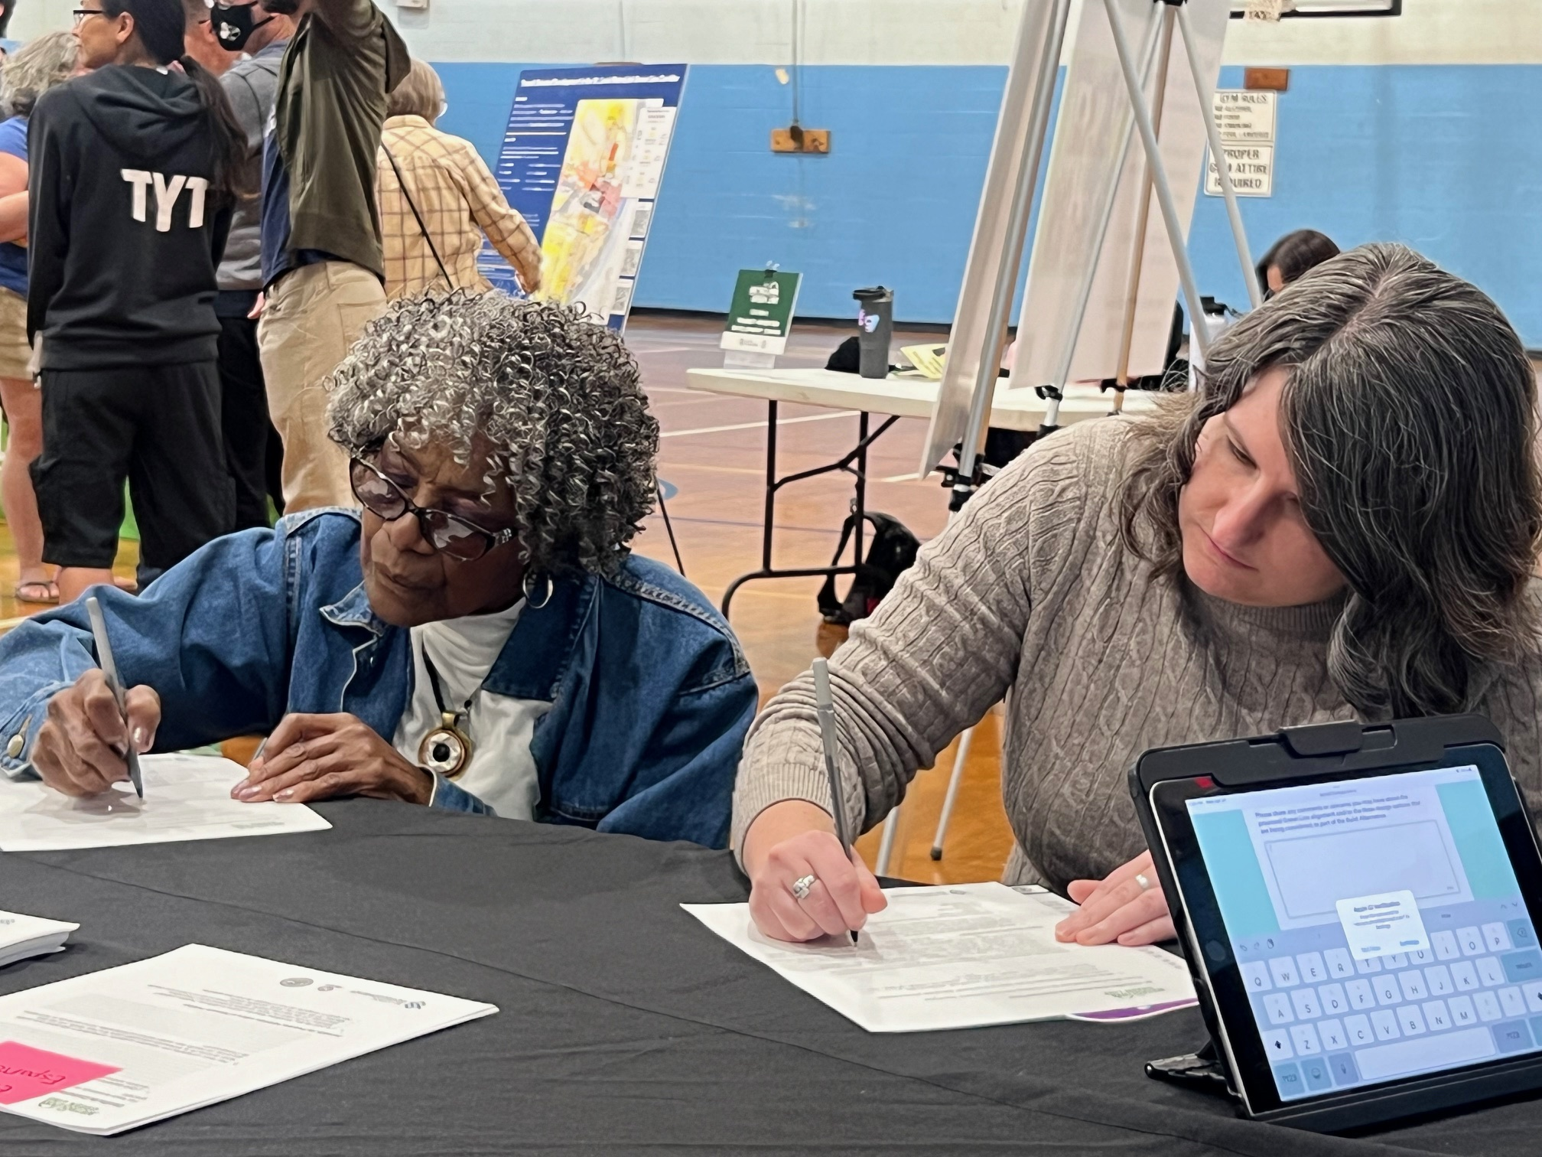
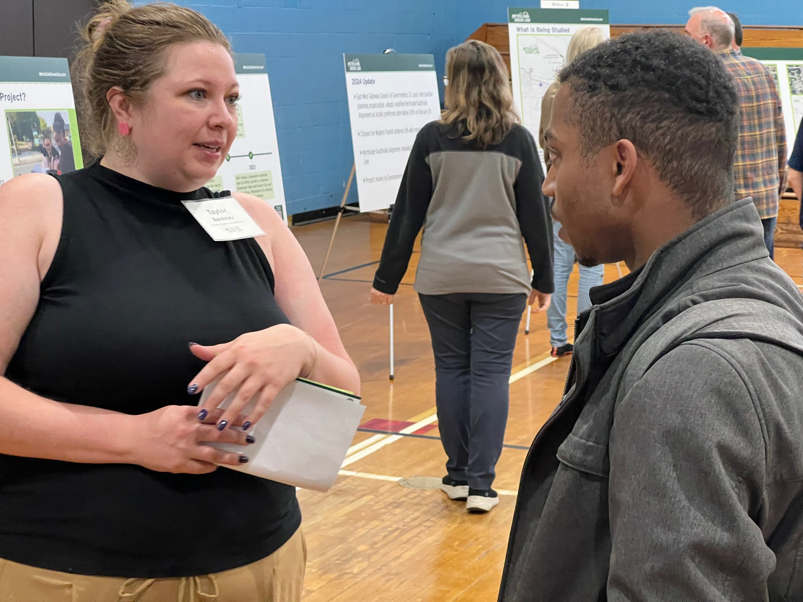
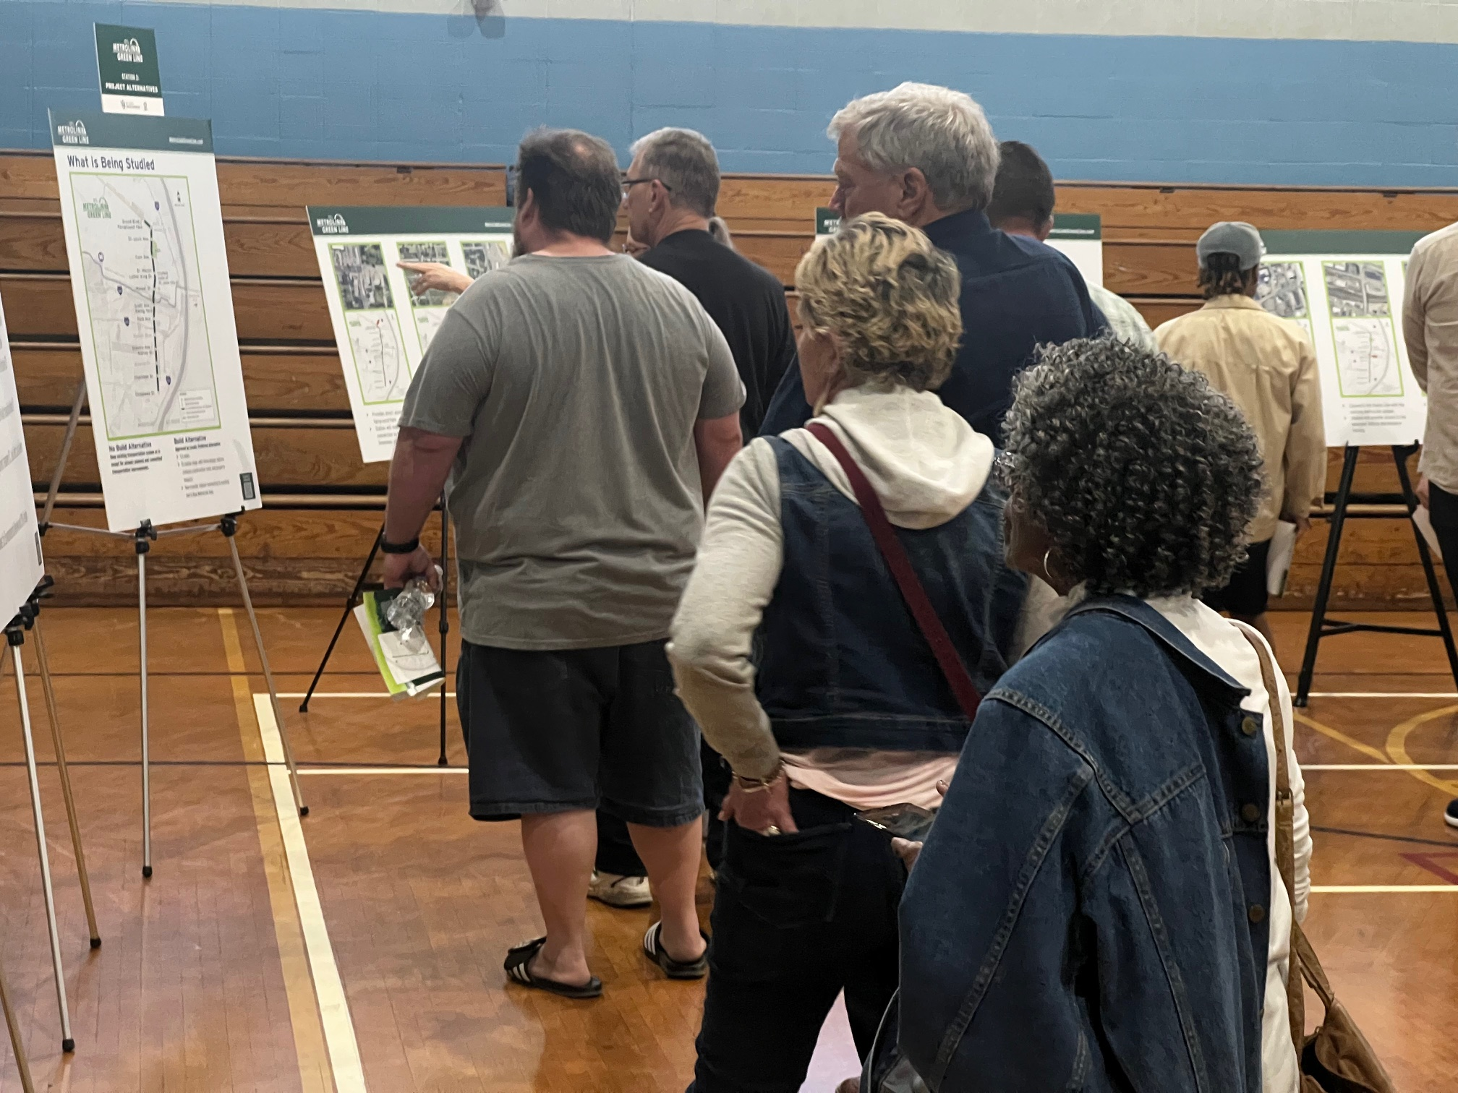
Get Involved!
Complete a comment form
Sign up to receive project updates at MetroLinkGreenLine.com
Follow us on social media:
@stlmetrolinkgreenline
@stlgreenline
@stlmetrolinkgreenline
Email questions to: info@MetroLinkGreenLine.com

Slide 20
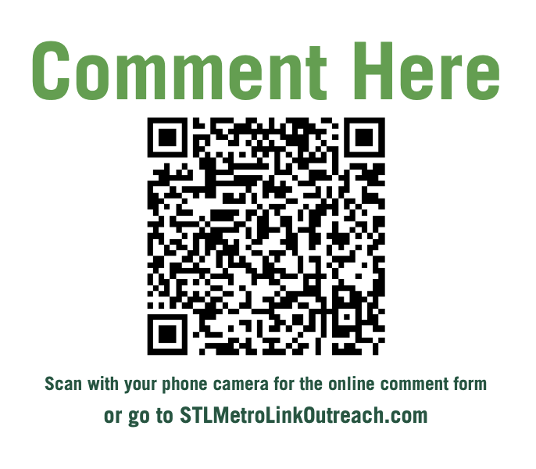

Slide 21
Q & A

