Slide 1

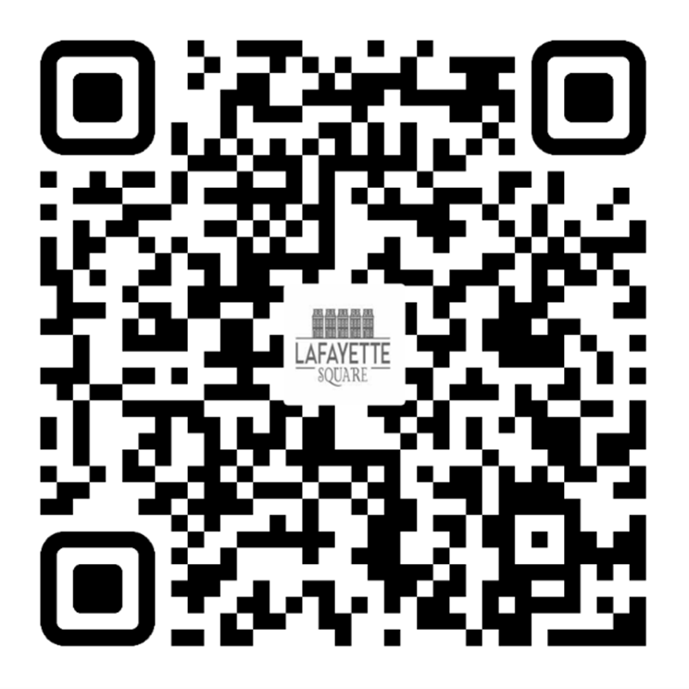
Membership Report
Chair of Membership - Charles Purnell & Jacob Malina
2026 LSNA MEMBERSHIP GOAL
50 NEW MEMBERSHIPS (350 TOTAL) &
15% OF RESIDENTS ARE LSNA MEMBERS
Count
May 315 / 15%
UNSURE IF YOU ARE A MEMBER OR
DO YOU HAVE QUESTIONS?
membership@lafayettesquare.org
JOIN TODAY

